Slide 1
Surface reconstruction from models for subtractive manufacturing simulation
Bernhard Manfred Gruber
Notes:
Welcome,
Next topic is in the area of computational geometry and industrial manufacturing

Slide 2
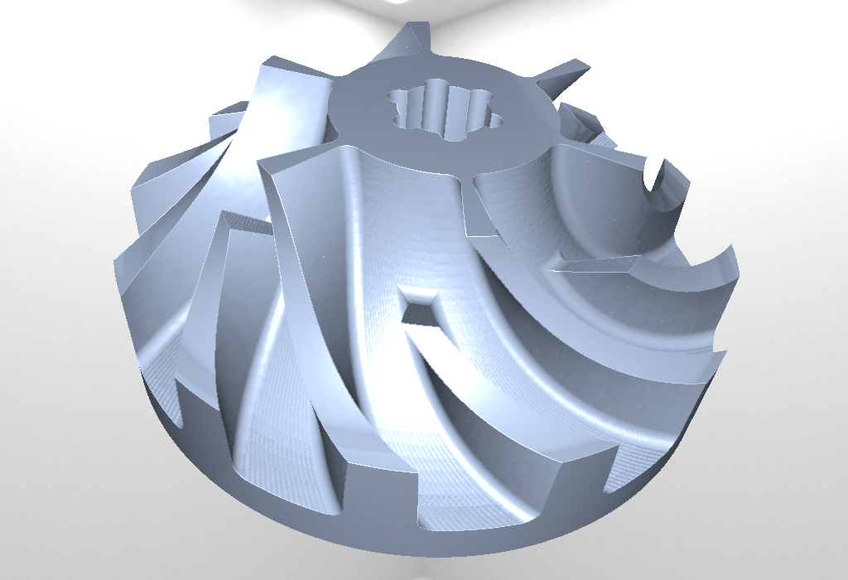
Overview
Subtractive manufacturing
Previous work
Problem statement
Approaches
Implementations
Results
Conclusion

Slide 3
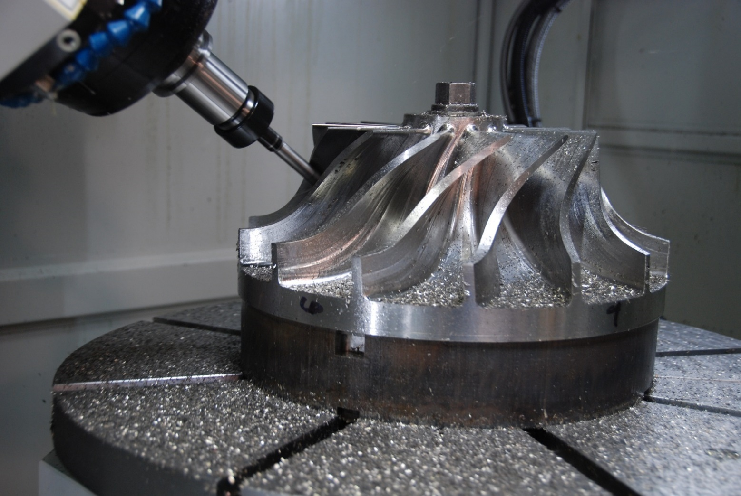
Subtractive manufacturing
http://www.hurco.com/IN/why-hurco/success-stories/blog/PublishingImages/nuconvmx42sr%20cutting.JPG
Notes:
Subtractive manufacturing, aka. Machining, is the process of shaping a piece of raw material, usually metal, into a final form.
nitial piece of metal called stock volume.
Each movement of cutting tool, which removes material, is called a sweep.

Slide 4
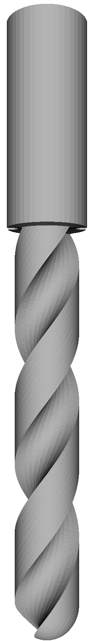
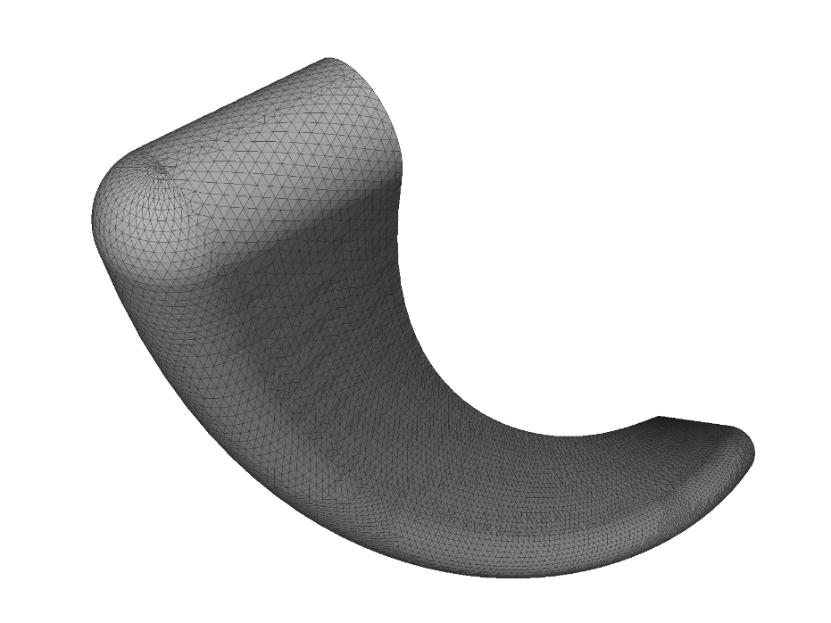
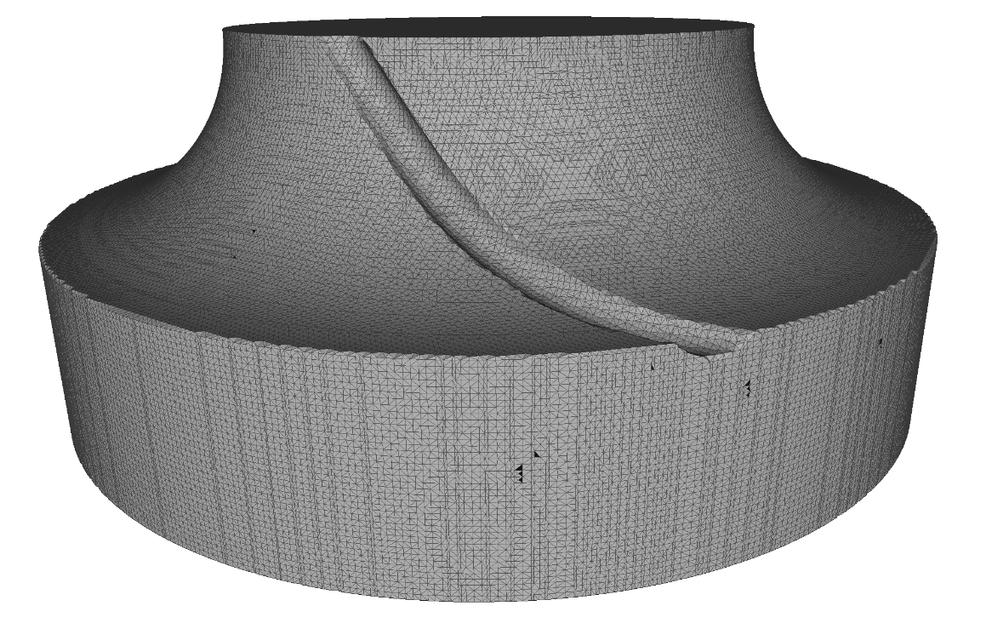
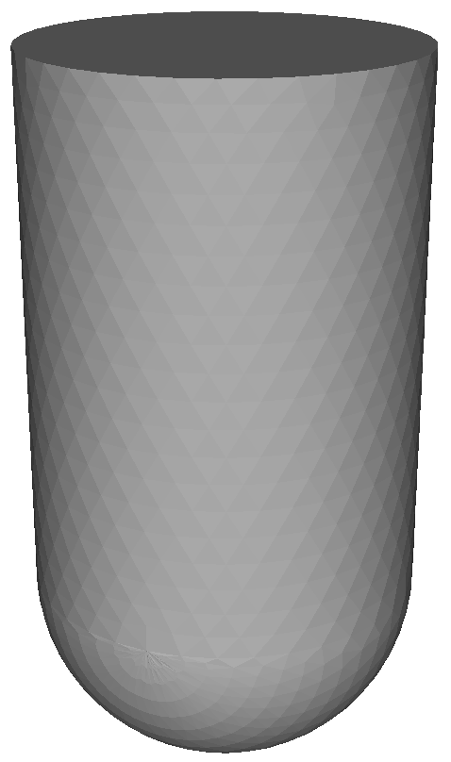
Subtractive manufacturing simulation
tool
subtraction
swept volume
simplified
tool
Notes:
subtractive manufacturing is simulated using triangle meshes of the stock and cutting tools.
tool is usually approximated by simplified version
tool is repeatedly moved using series of transformations, producing a swept volume with each sweep.
swept volumes are then subtracted from the stock volume

Slide 5




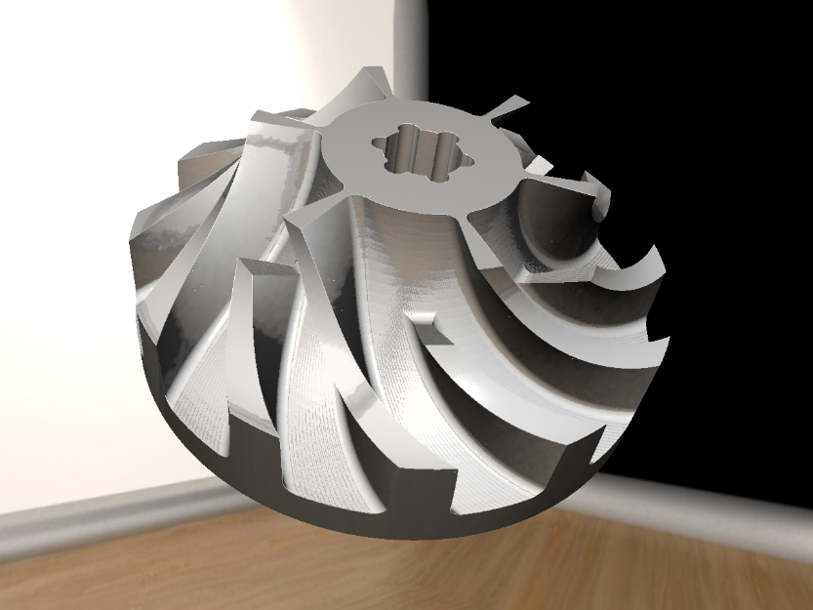
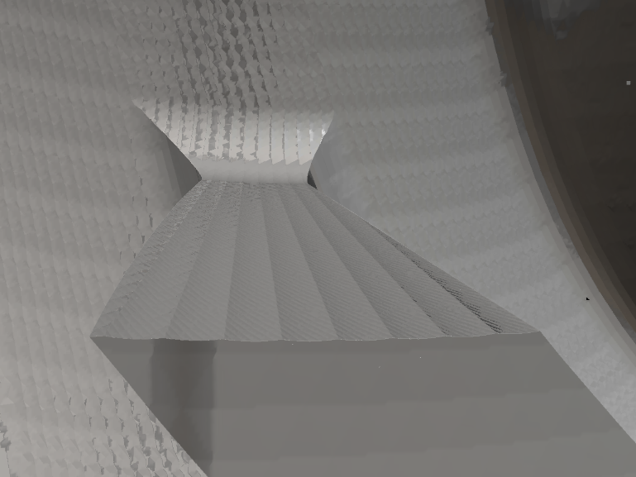
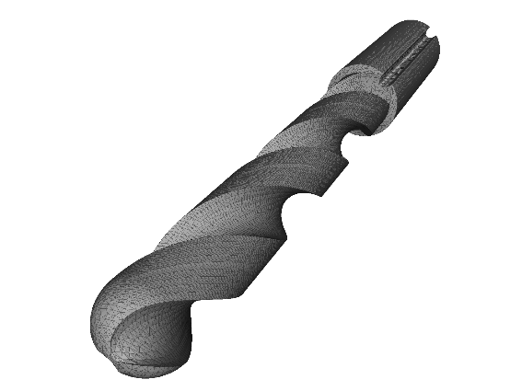
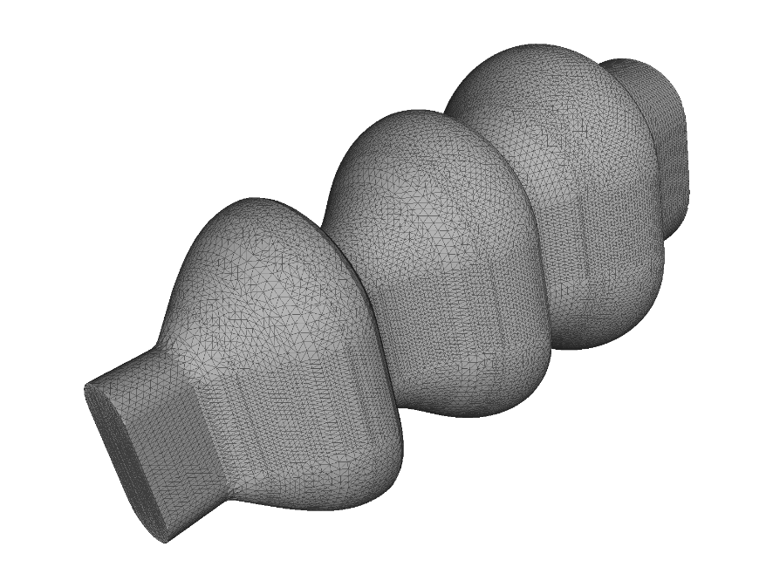
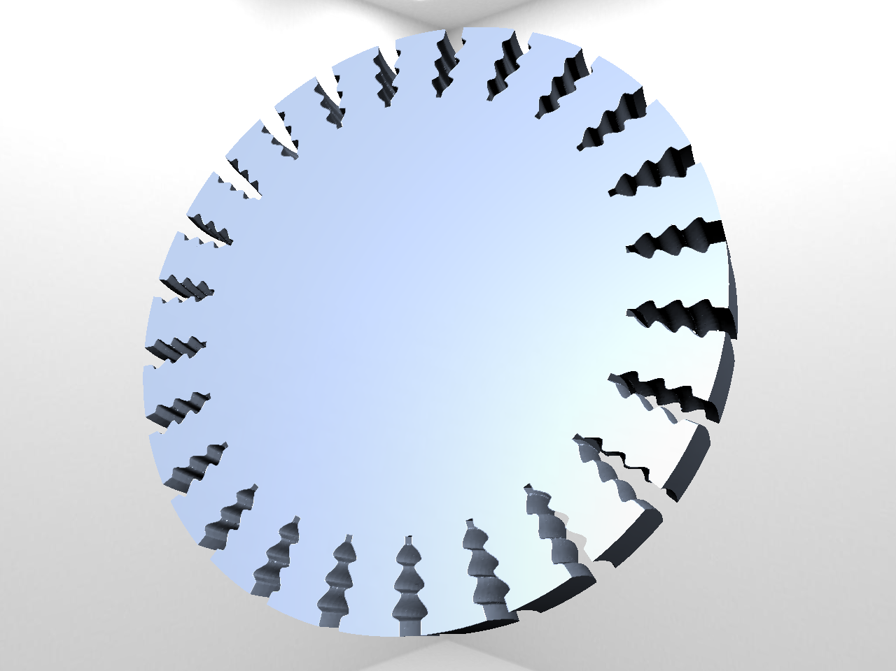
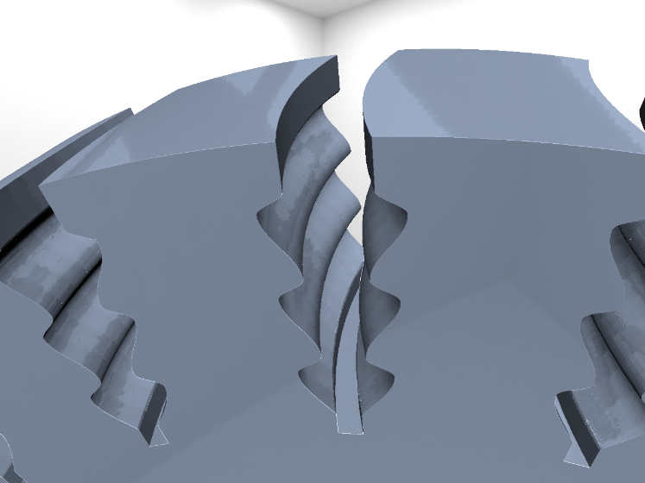
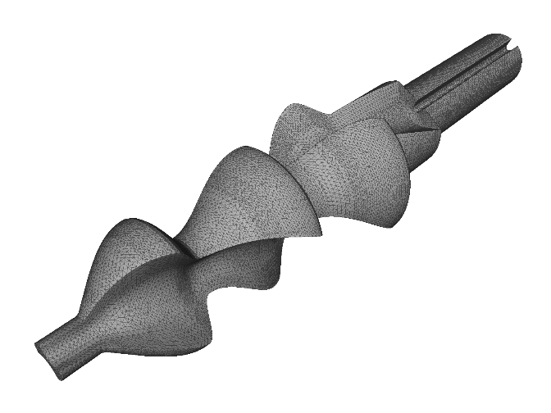
Previous work – VML
Notes:
Foundational to thesis, VML, already implemented most of subtractive manufacturing simulation
Swept volume computation from given tools
Swept volumes can be added to simulate machining process
Custom raycasting algorithm for visualization
Main goals of VML are speed and especially precision

Slide 6
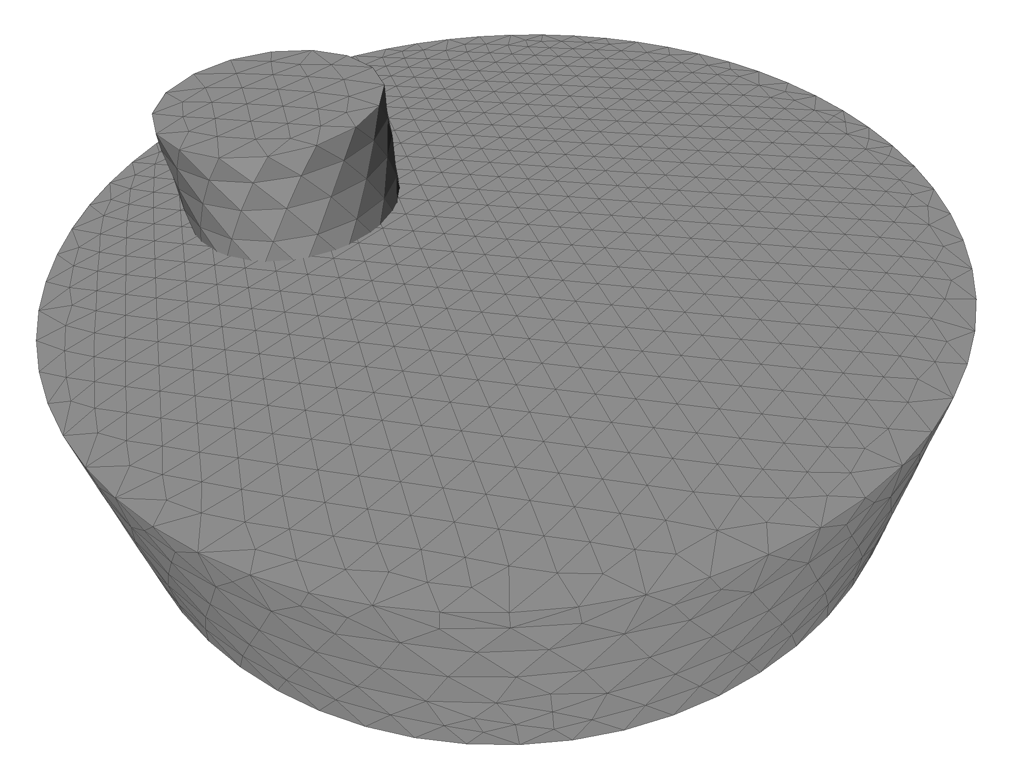
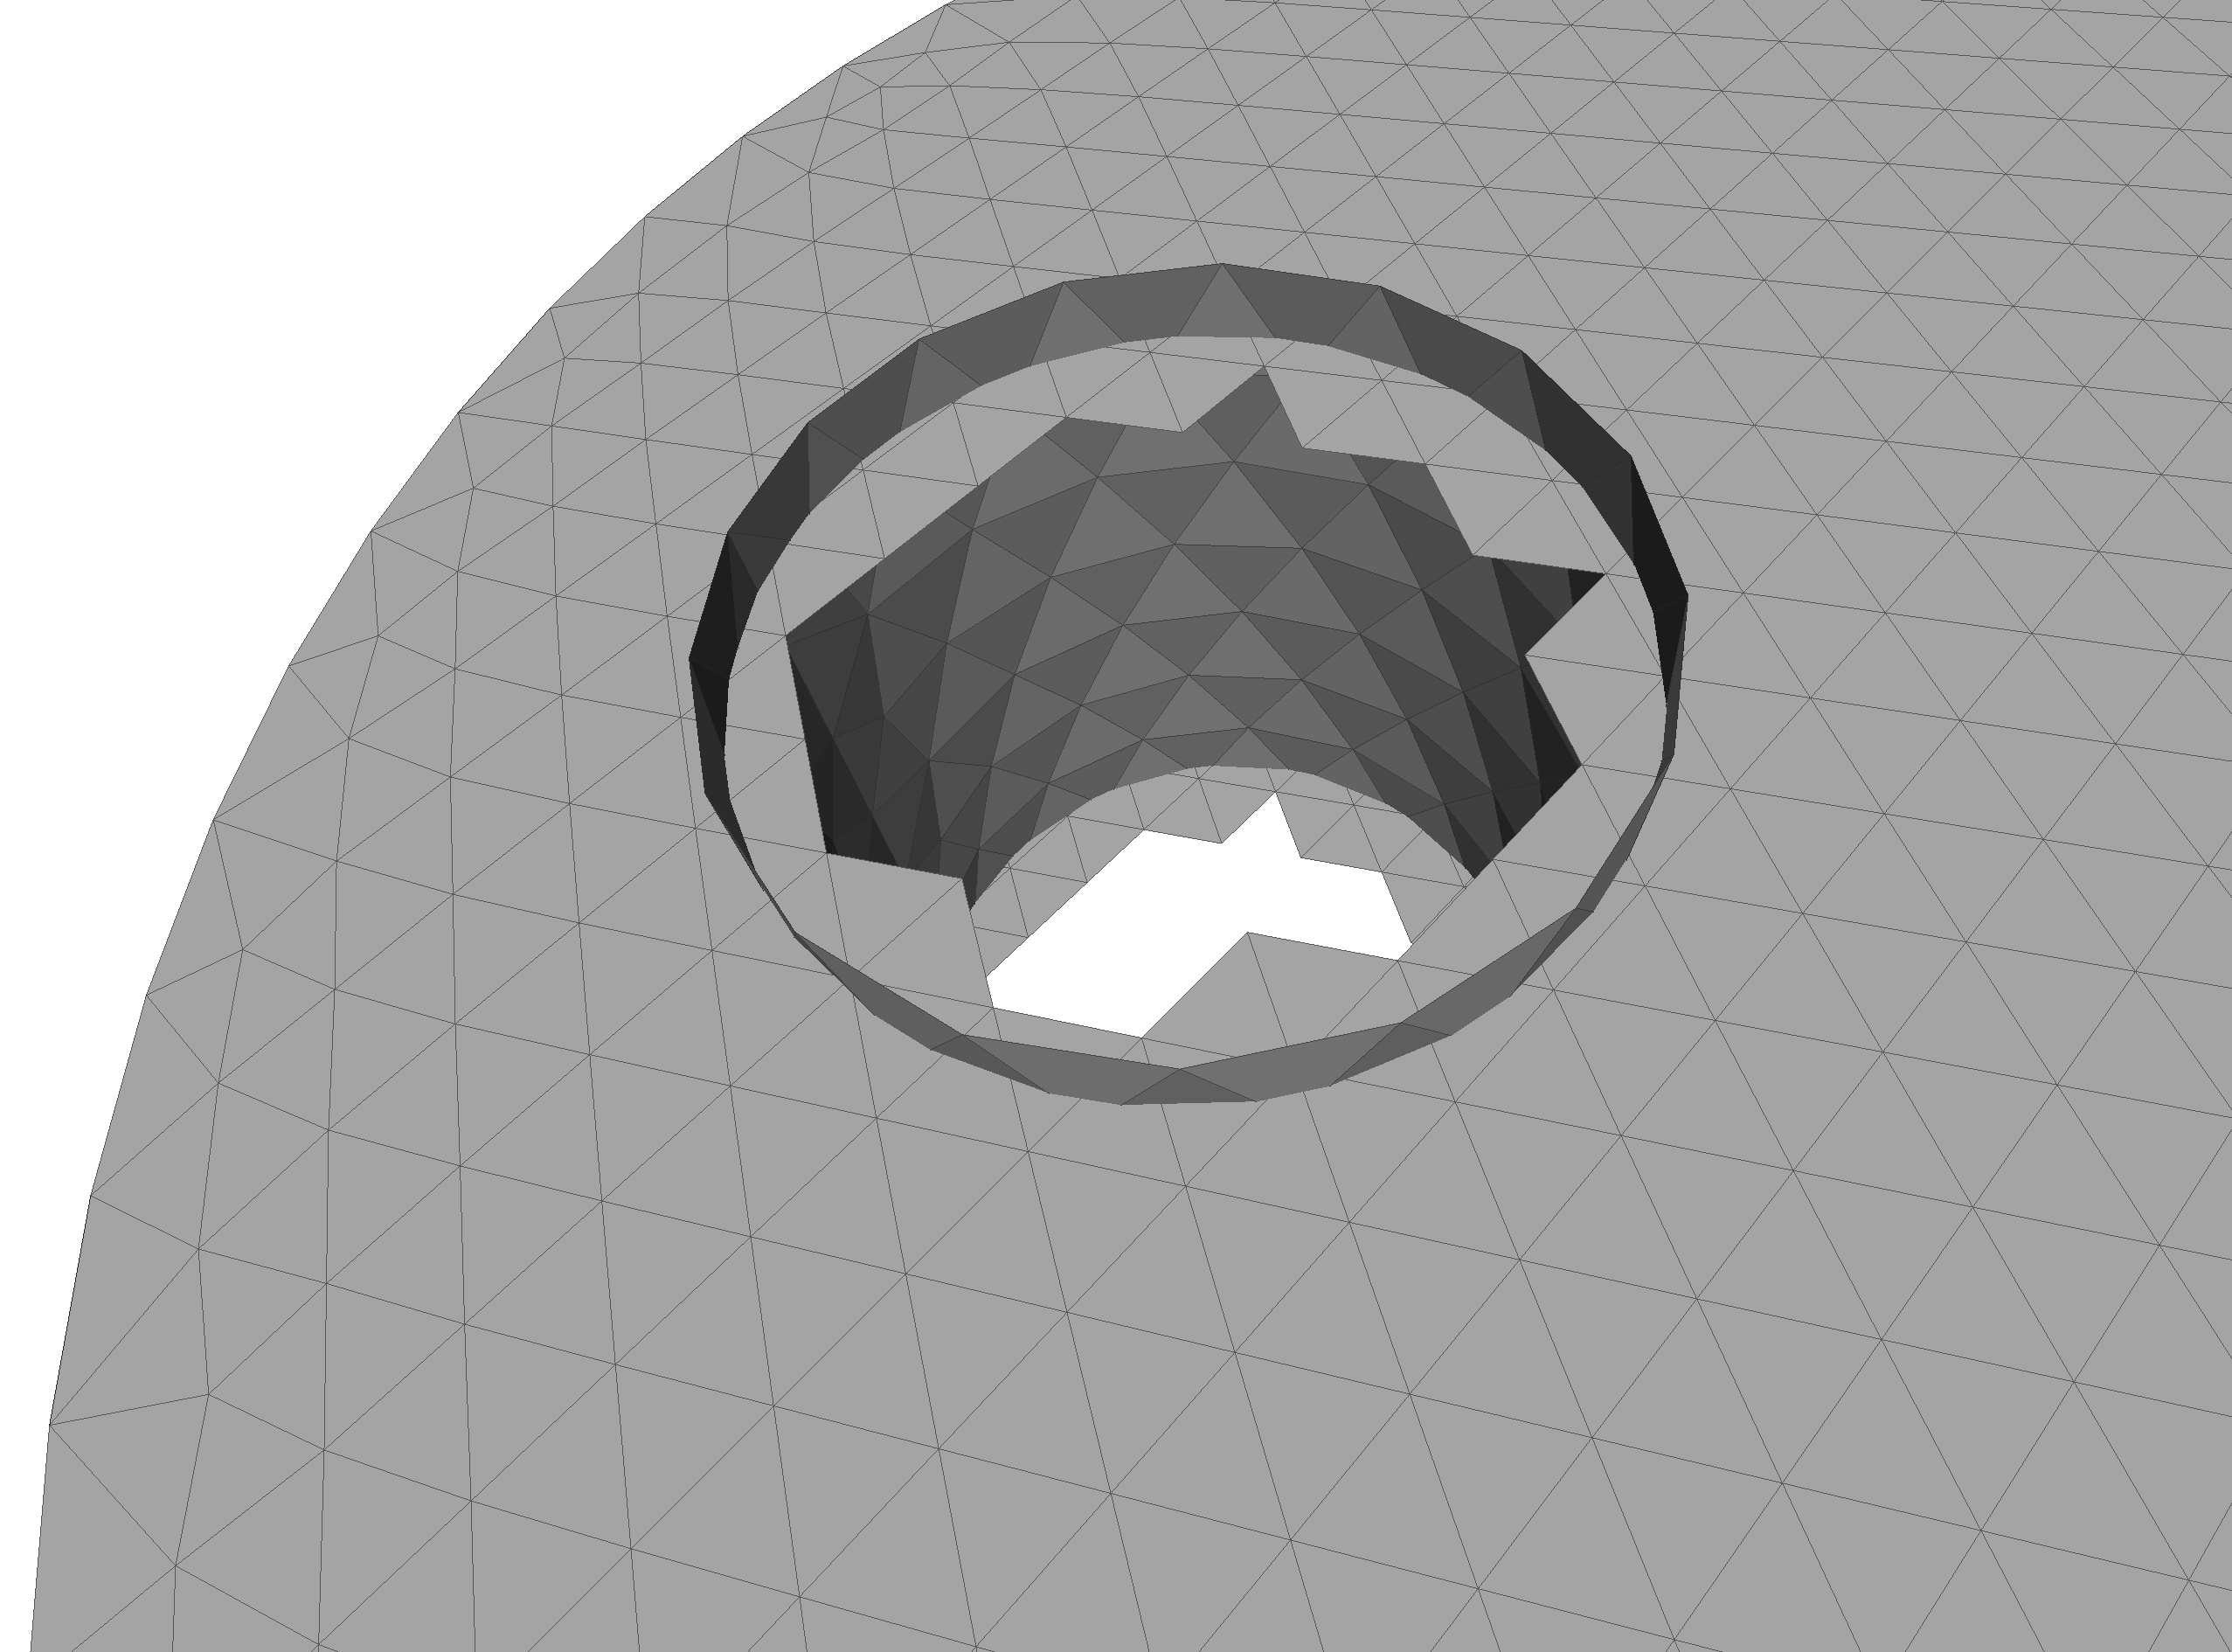
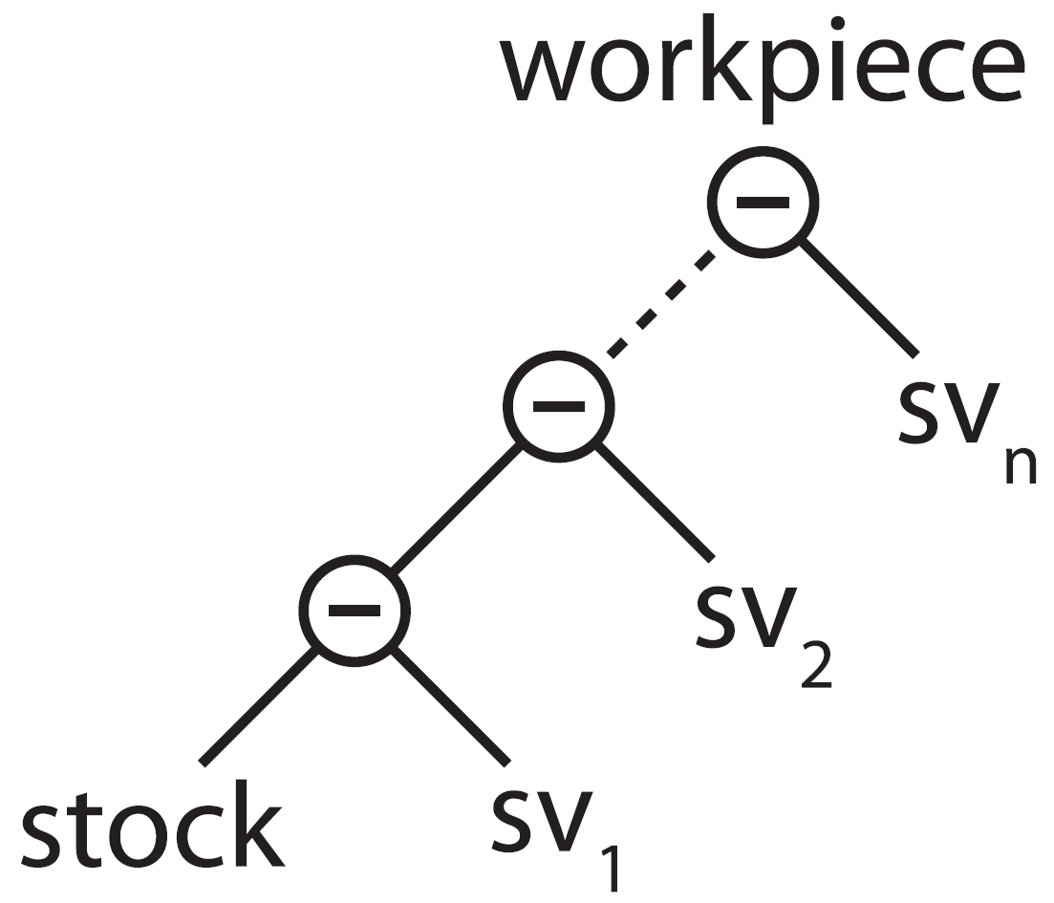
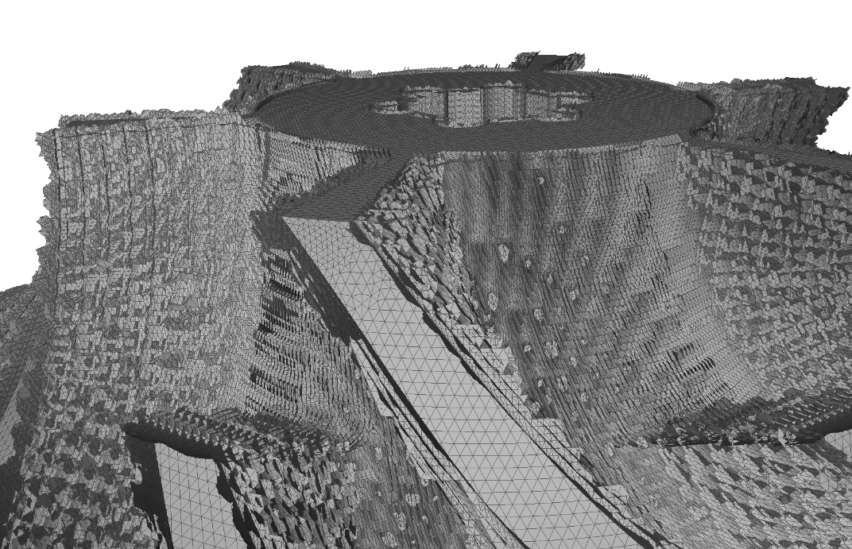
VML data model
Notes:
To maintain precision, VML does not compute Boolean subtractions, but simply stores the SV
Can therefore be seen as maintaining a linearized CSG tree of the stock and a series of SV
To keep triangle count within manageable bounds, a triangle elimination strategy has been developed
Removes triangles which do not contribute to surface of the workpiece
(graphics)
For visualization, the actual surface of the workpiece is sampled by a raycast, which computes the Boolean subtractions on the fly

Slide 7
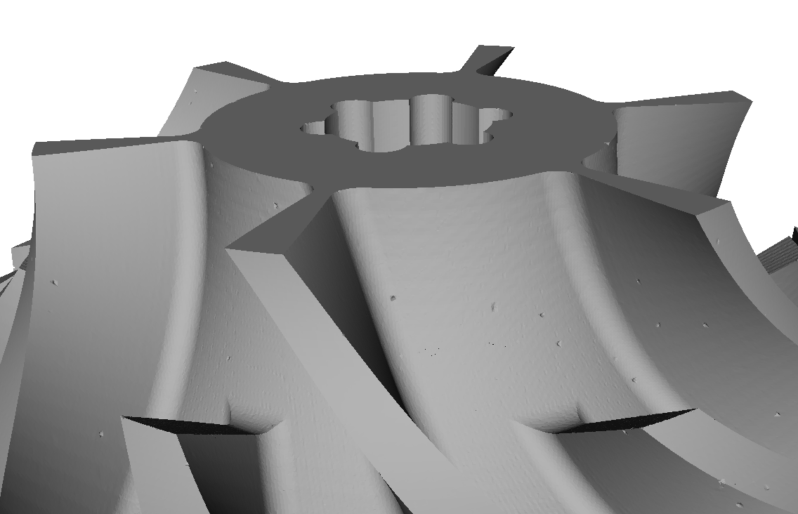
Problem statement
Extract triangulated surface from VML data model
Prototypic implementations
Testing on selected scenes
Comparison
Runtime, memory, complexity, errors, numeric stability, mesh quality, visual quality, feature conservation, …
Notes:
However, there are situations where a mesh of the final workpiece is desired, e.g. for verification or physics simulations
This was the goal of my thesis, to extract a triangulated surface …
Several prototypes have been implemented and tested on a few scenes
Compared using various paramteres

Slide 8
Approaches
Direct intersection of swept volumes
Most naïve, theoretically most accurate
Point cloud based
Point cloud easy to create using raycast
Reconstruction using region-growing on points
Reconstruction using function fitting
Tri-dexel
Dexel images easy to create using raycast
Reconstruction from tri-dexel grid
direct
sampling

Slide 9
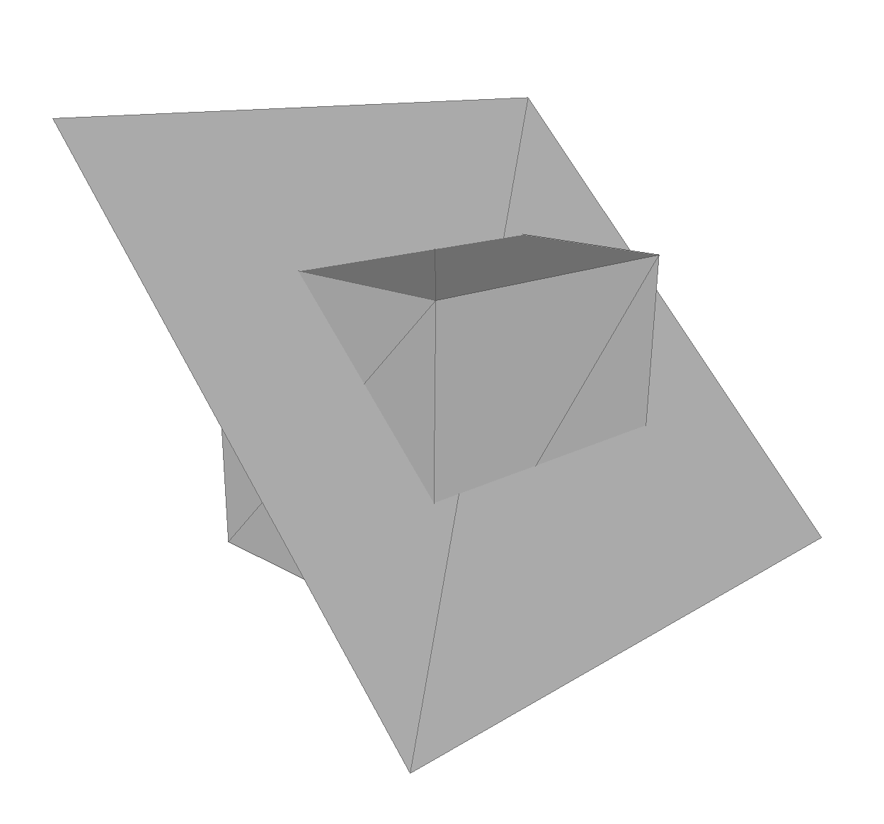
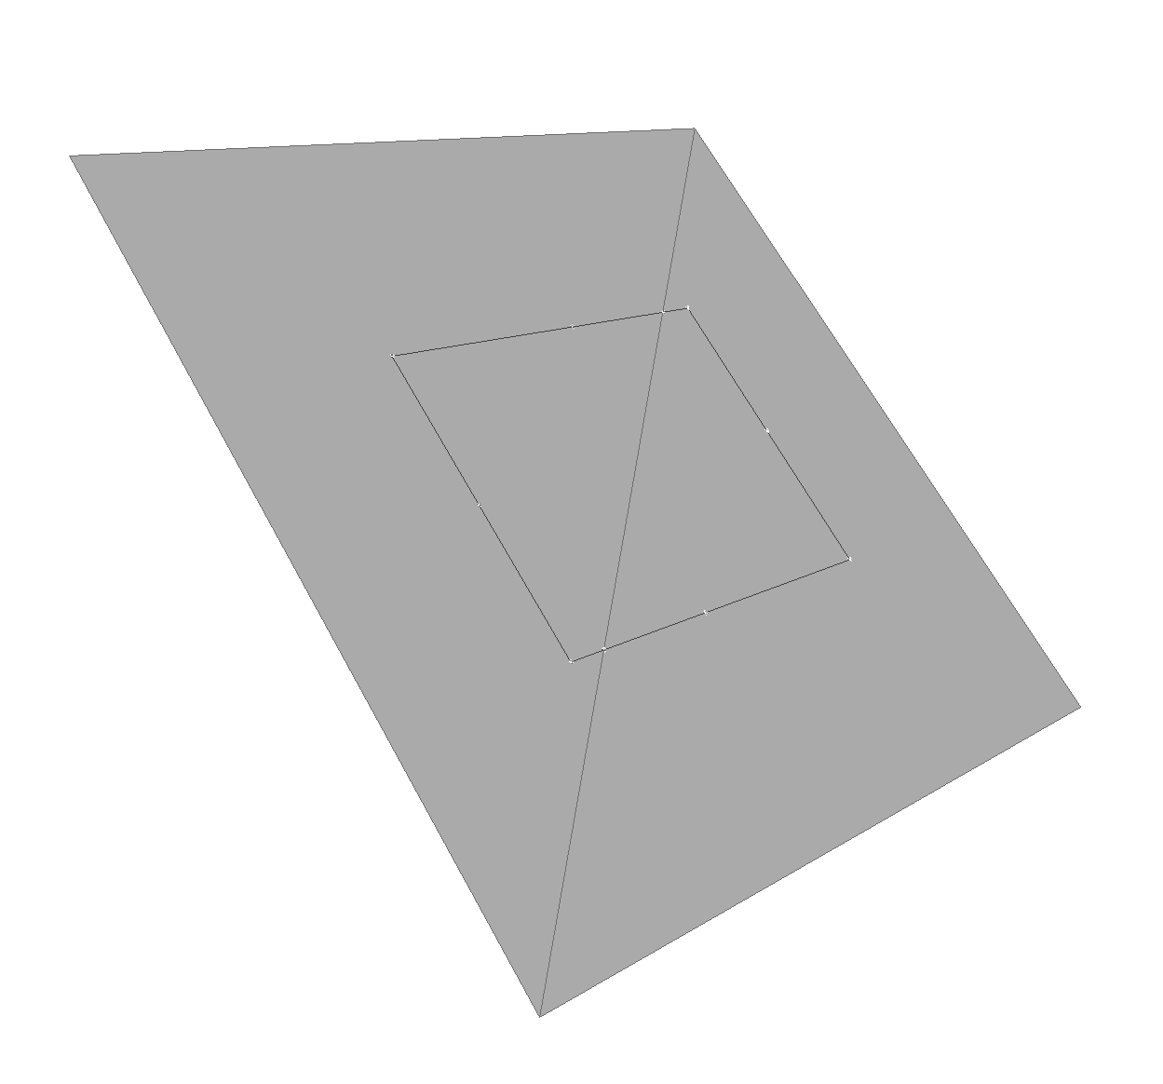
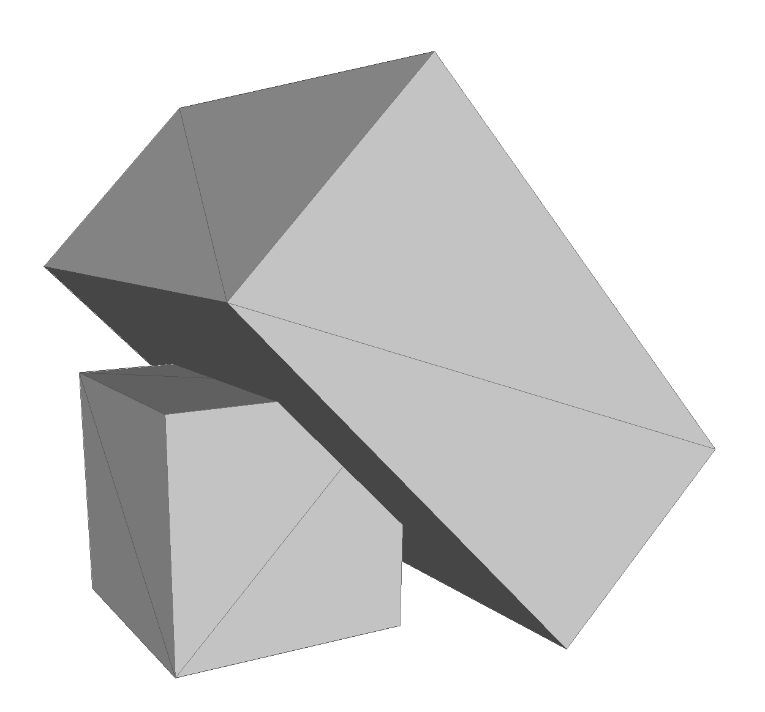
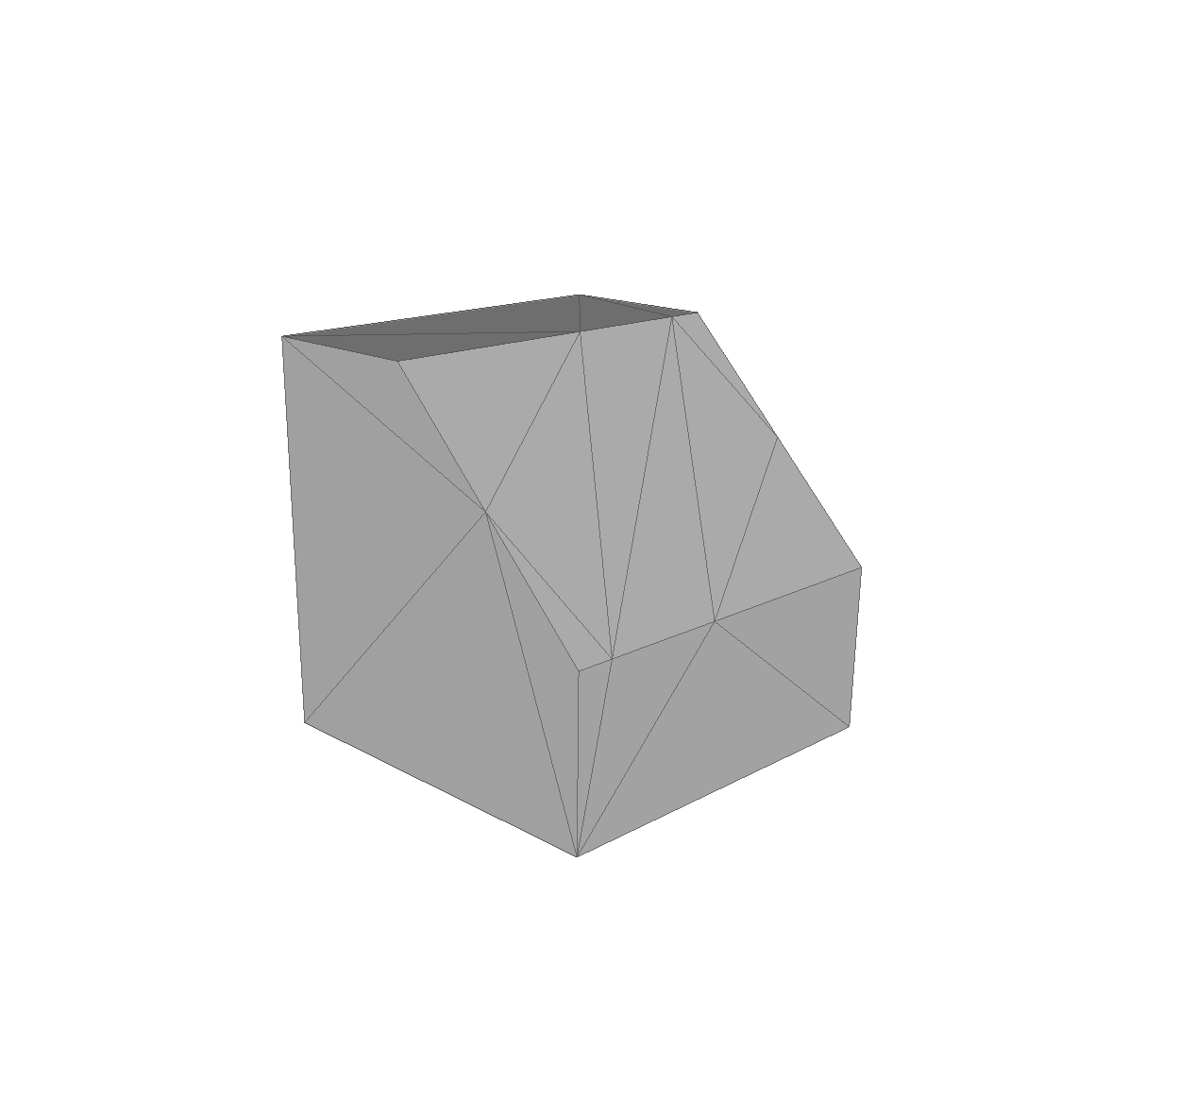

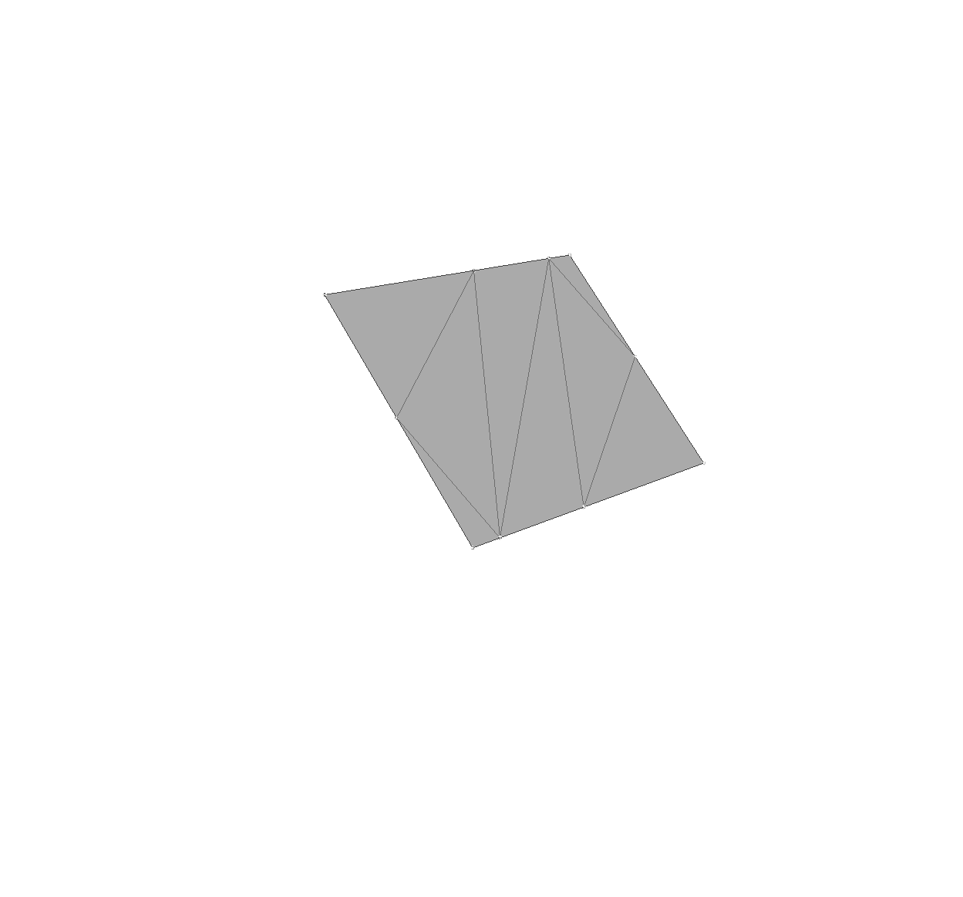
Direct intersection

Slide 10
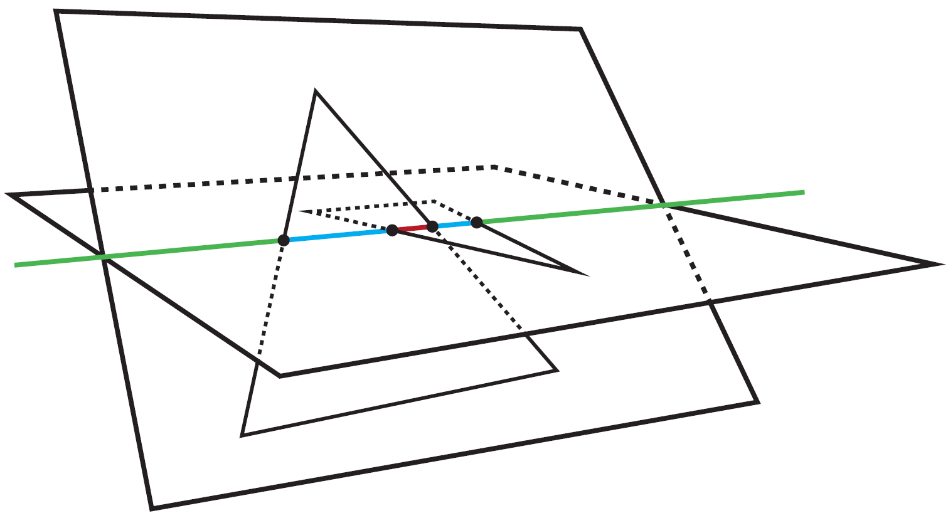
Direct intersection
Thomas Möller, A fast triangle-triangle intersection test, 1997
David Rosen, Seamless Intersection Between Triangle Meshes, 2008

Slide 11
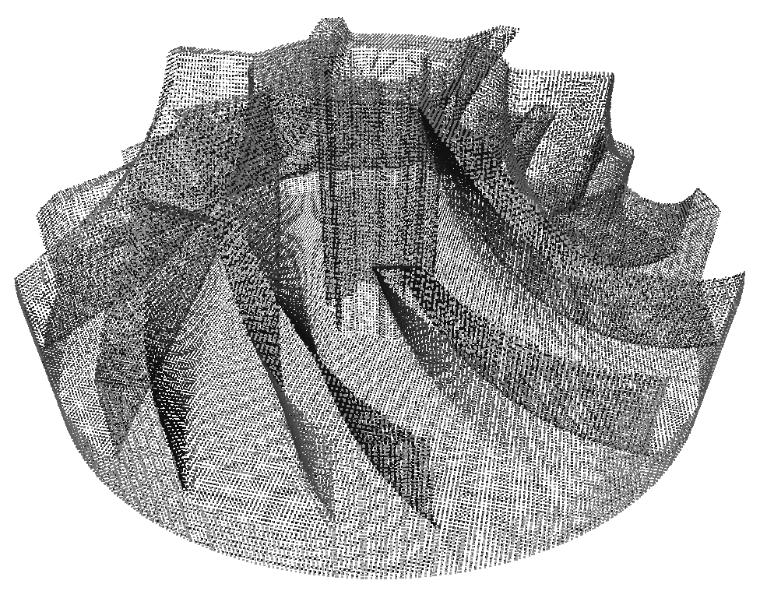
Point cloud based
3 axis-aligned raycasts to sample point cloud

Slide 12
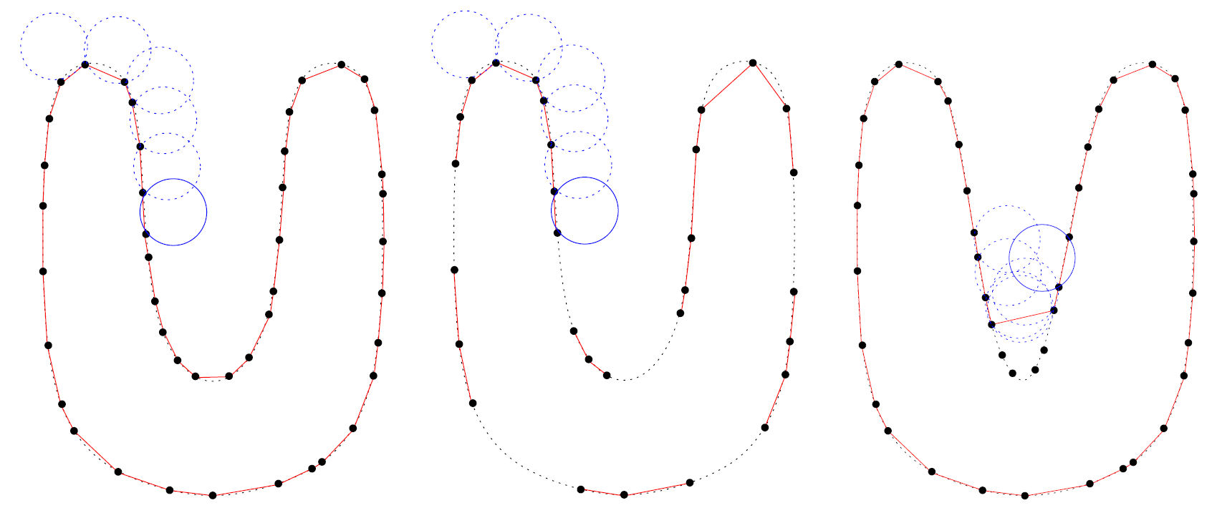
Ball pivoting algorithm (BPA)
Fausto Bernardini et.al., The ball-pivoting algorithm for surface reconstruction, 1999

Slide 13
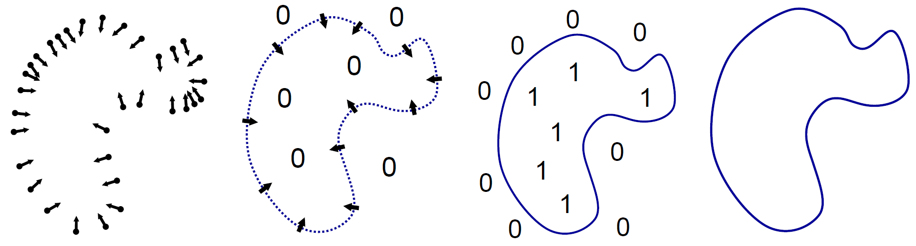
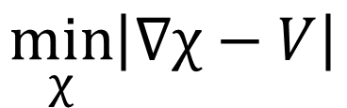
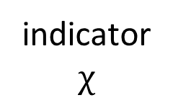
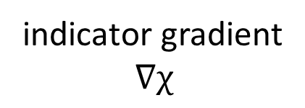
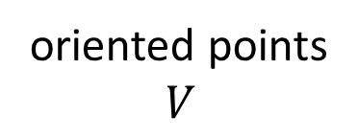
Poisson
oriented points $$V$$
indicator gradient $$∇χ$$
indicator $$χ$$
isosurface
$$\min_{χ}\left|∇χ−V\right|$$
Michael Kazhdan etal., Poisson Surface Reconstruction, 2006

Slide 14
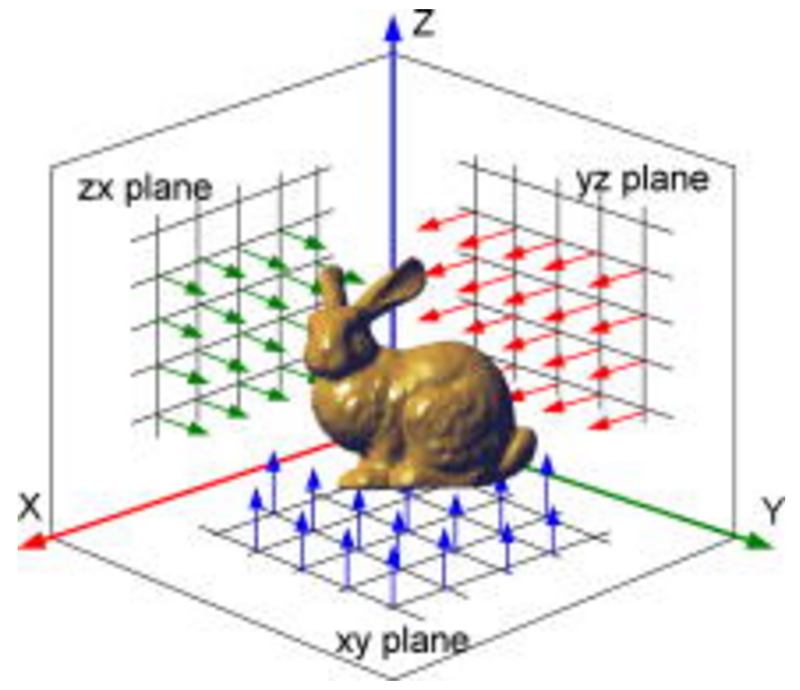
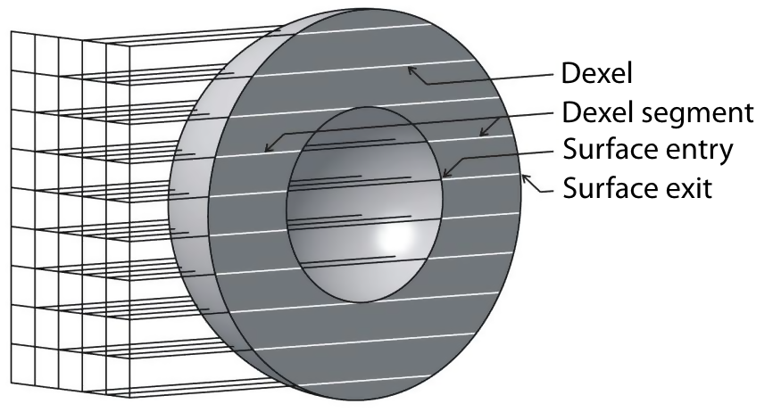
Tri-dexel
Balázs Tukora, Material removal simulation and cutting force prediction of multi-axis machining processes on general-purpose graphics processing units, 2012
http://computingengineering.asmedigitalcollection.asme.org/article.aspx?articleid=1401455

Slide 15
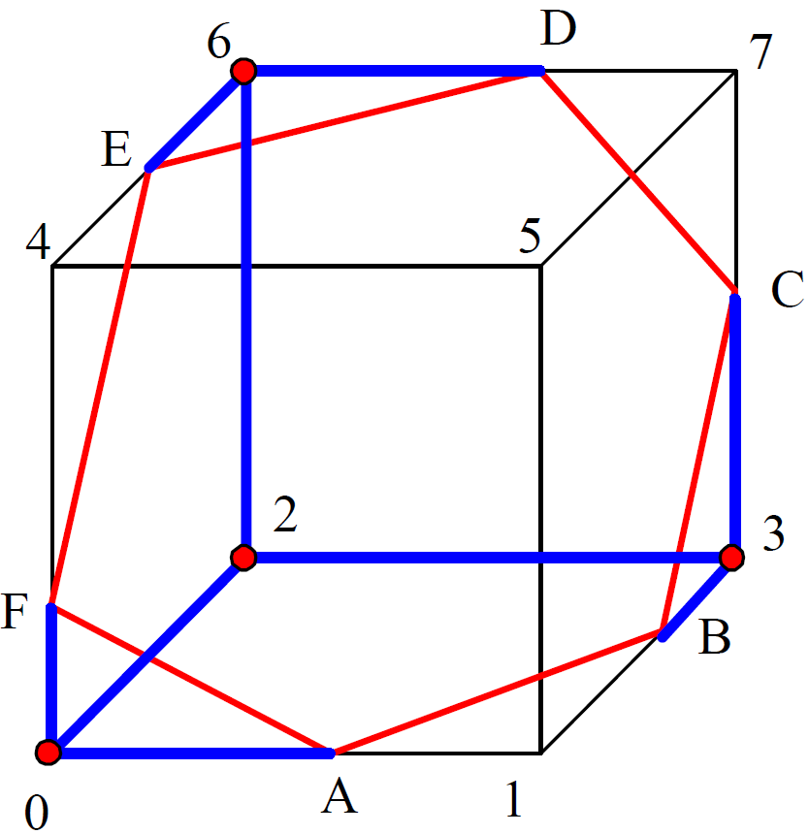
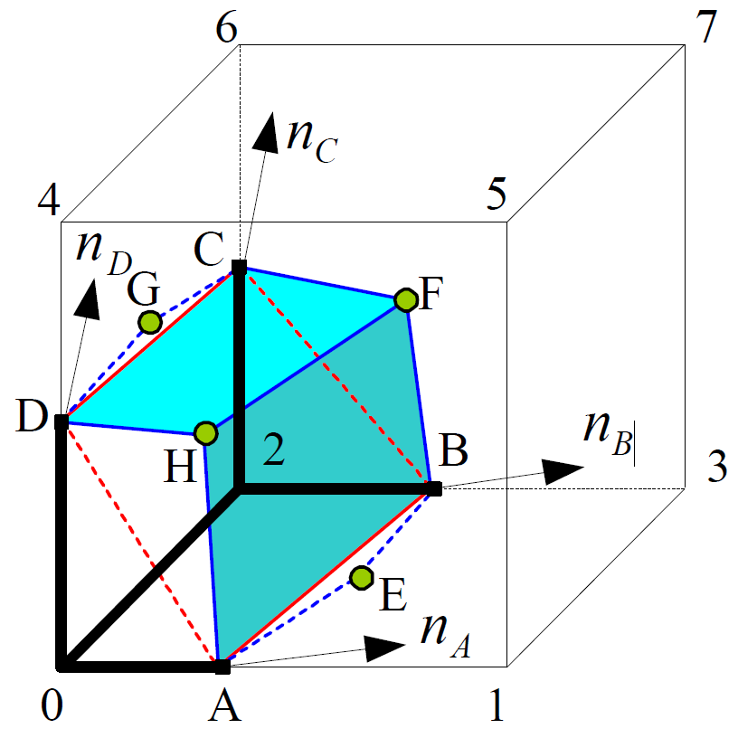
Tri-dexel
Yongfu Ren et al., Feature conservation and conversion of Tri-dexel volumetric models to polyhedral surface models for product prototyping, 2008
Notes:
Based on the 3D grid created by the 3 dexel images, the dexel information can be reorganized into cells

Slide 16
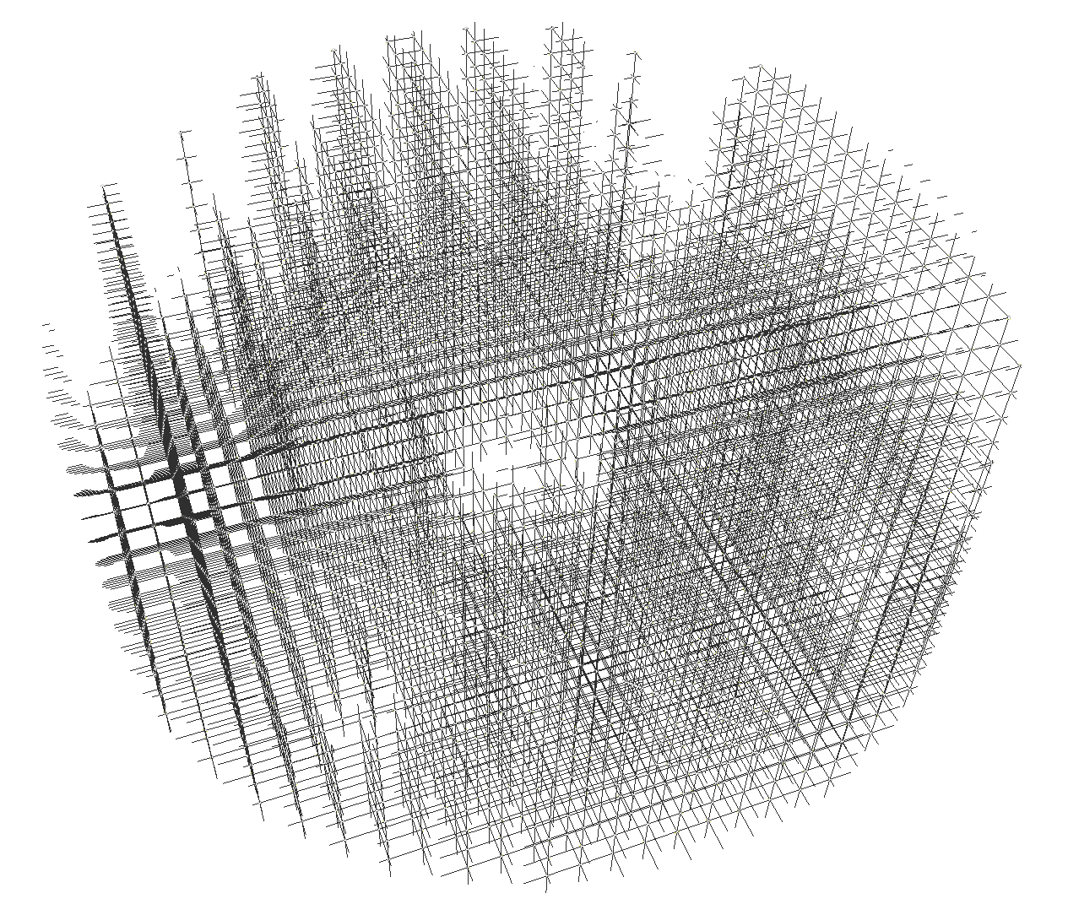
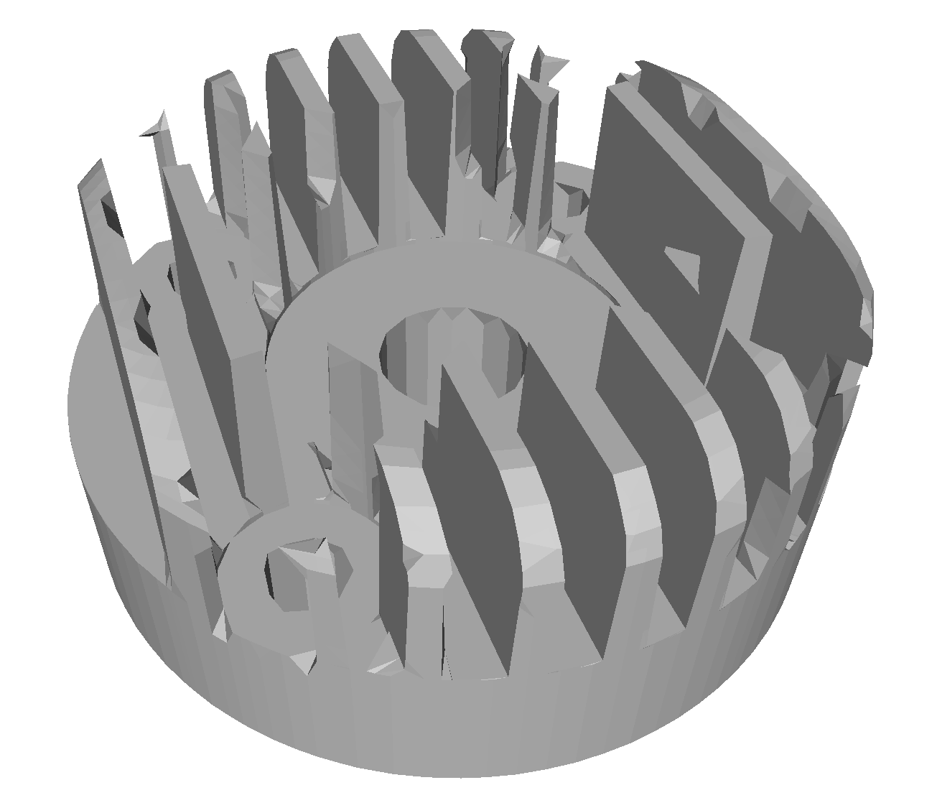
Tri-dexel

Slide 17
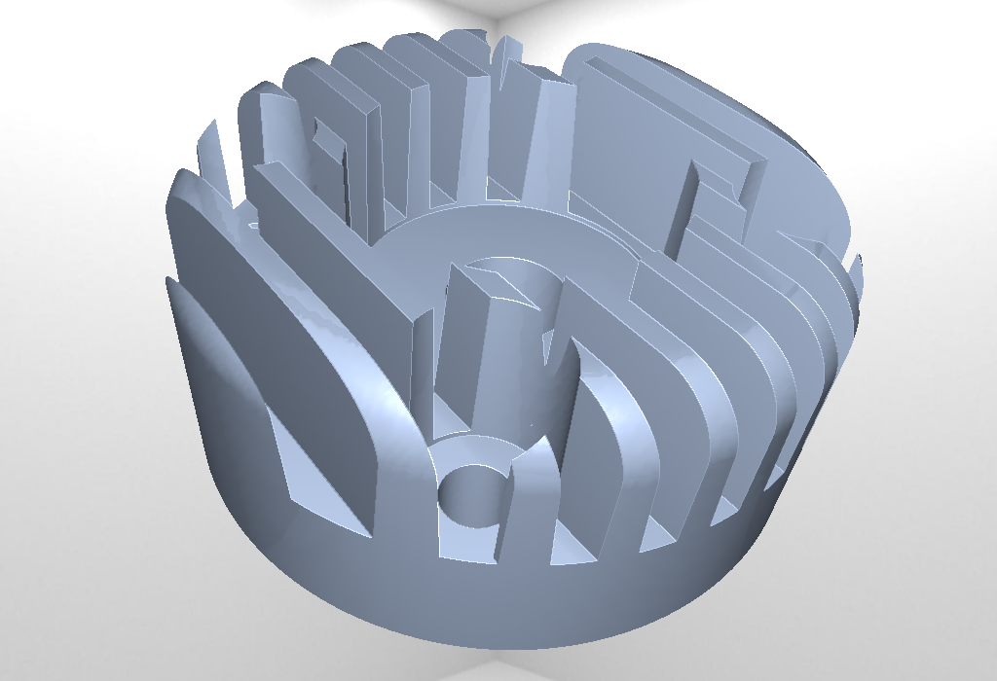
Test scenes
cylinder_head
impeller
20 SV 80k Δ
2383 SV
6M Δ

Slide 18
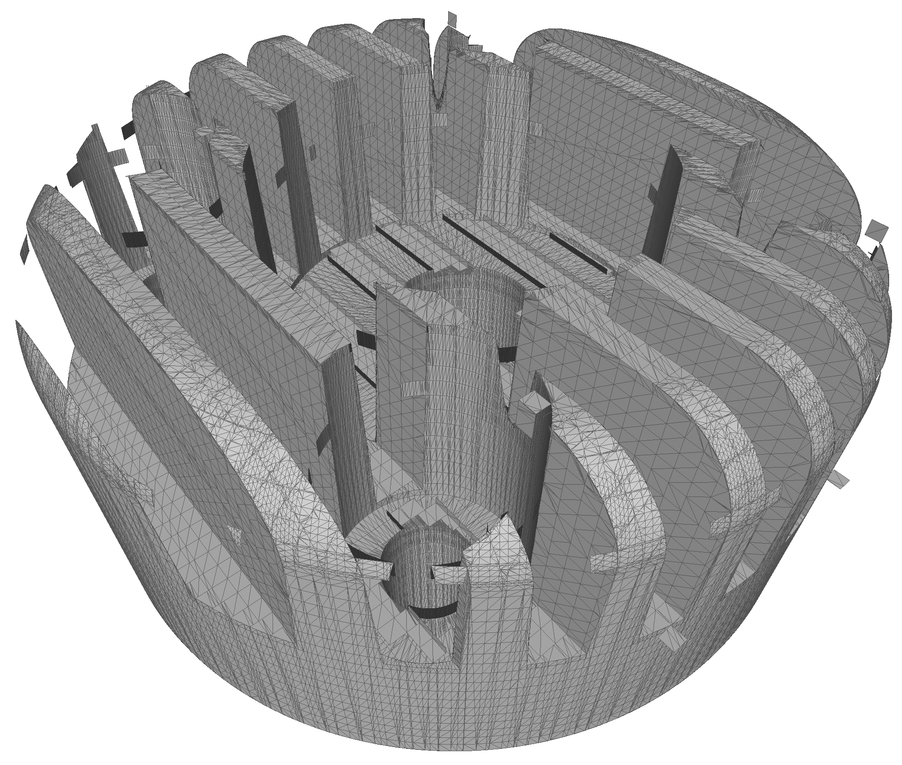
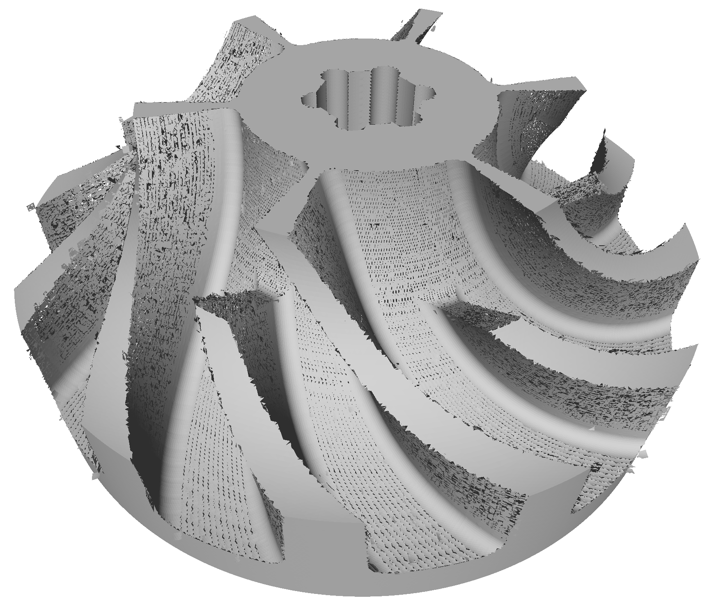
Results – Direct intersection
229ms
149k Δ
21s
1.7M Δ

Slide 19
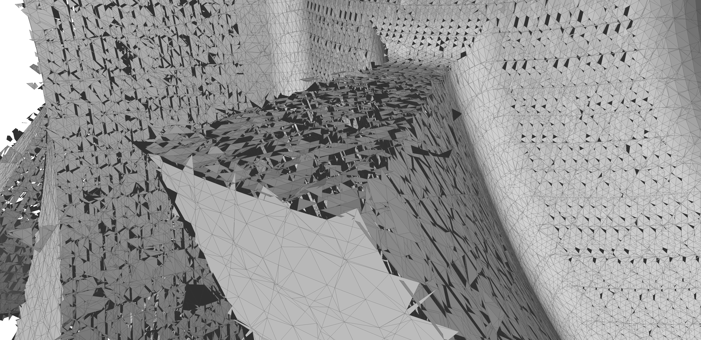
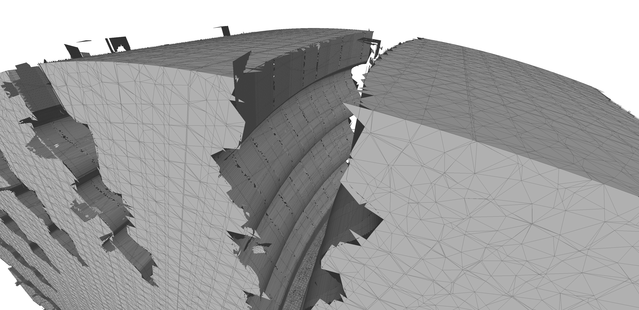
Results – Direct intersection

Slide 20
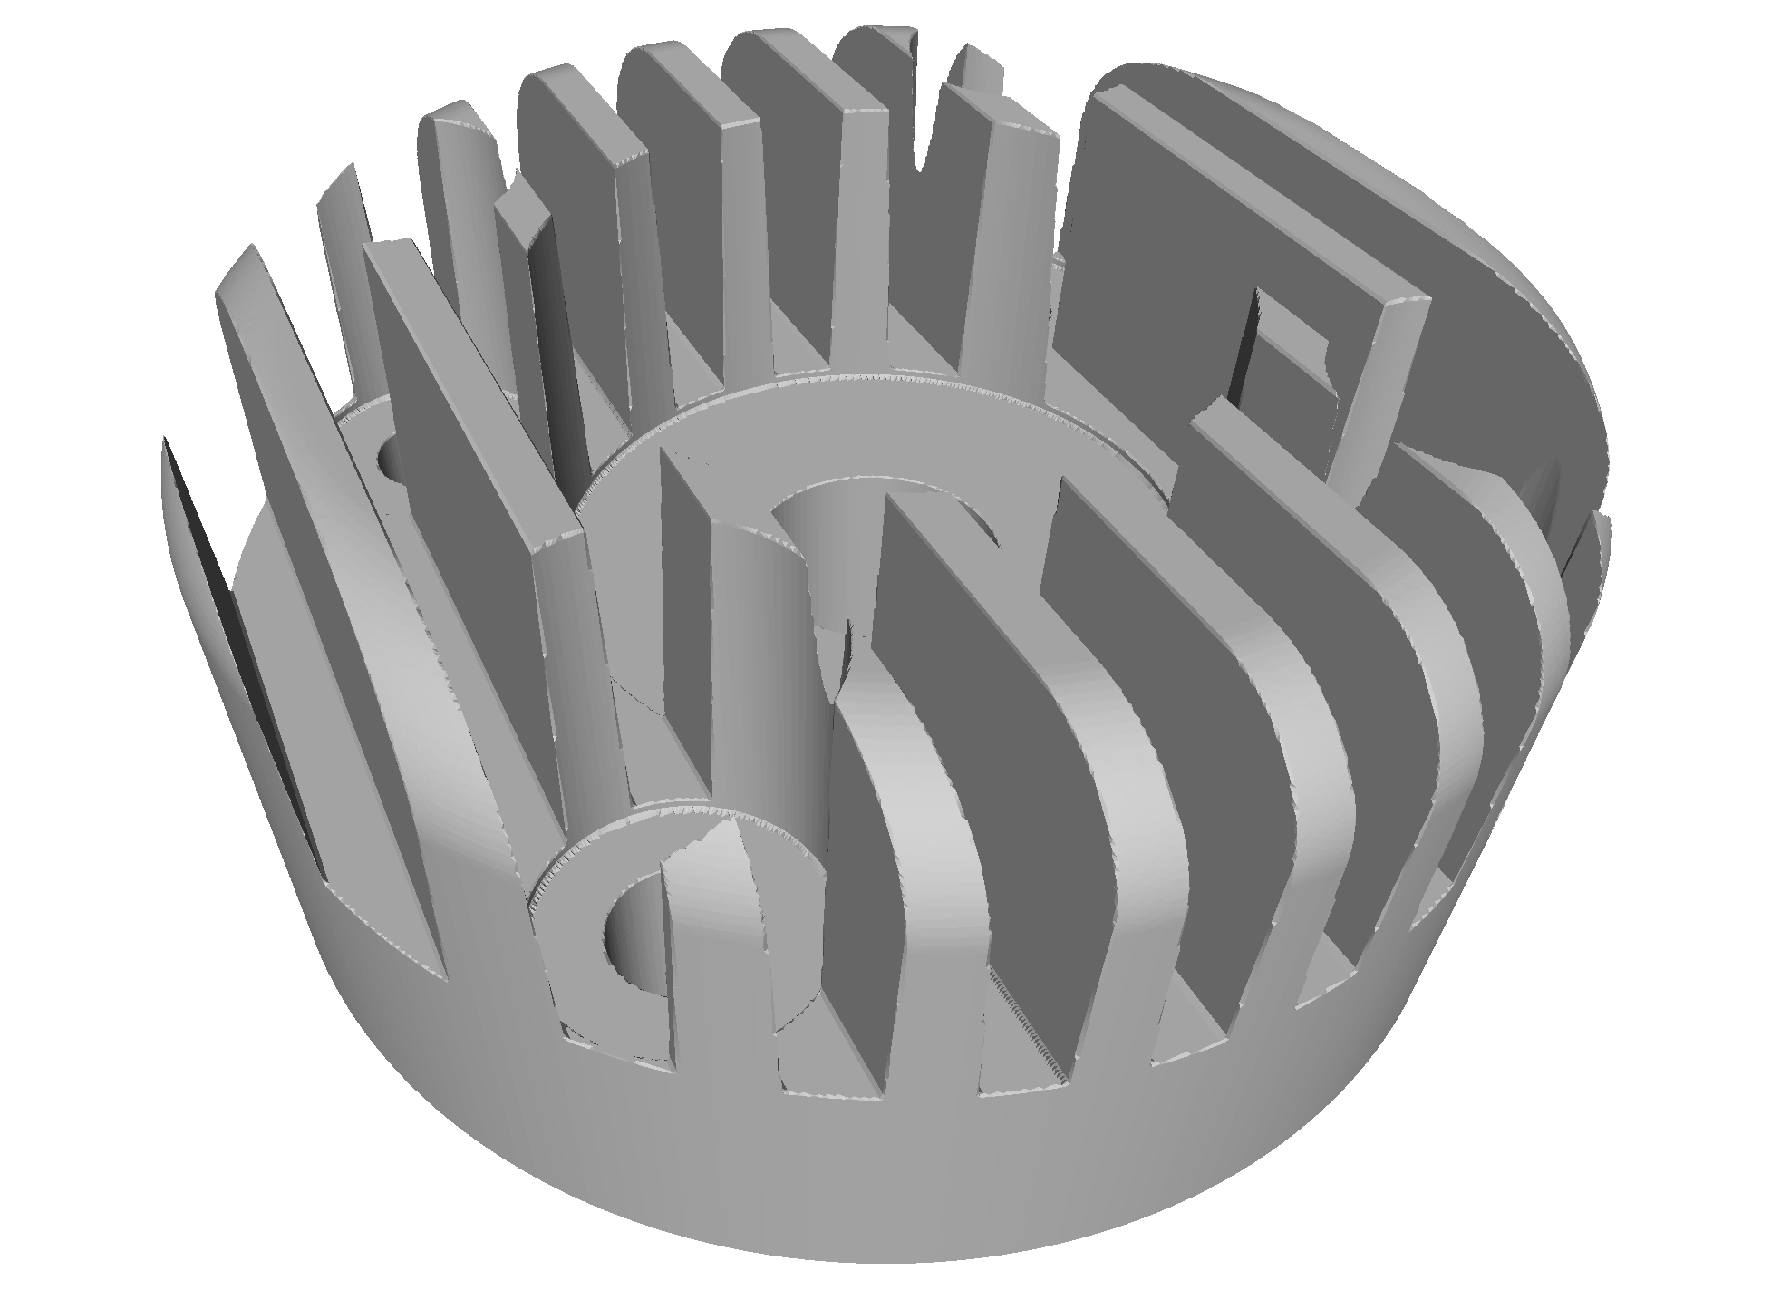
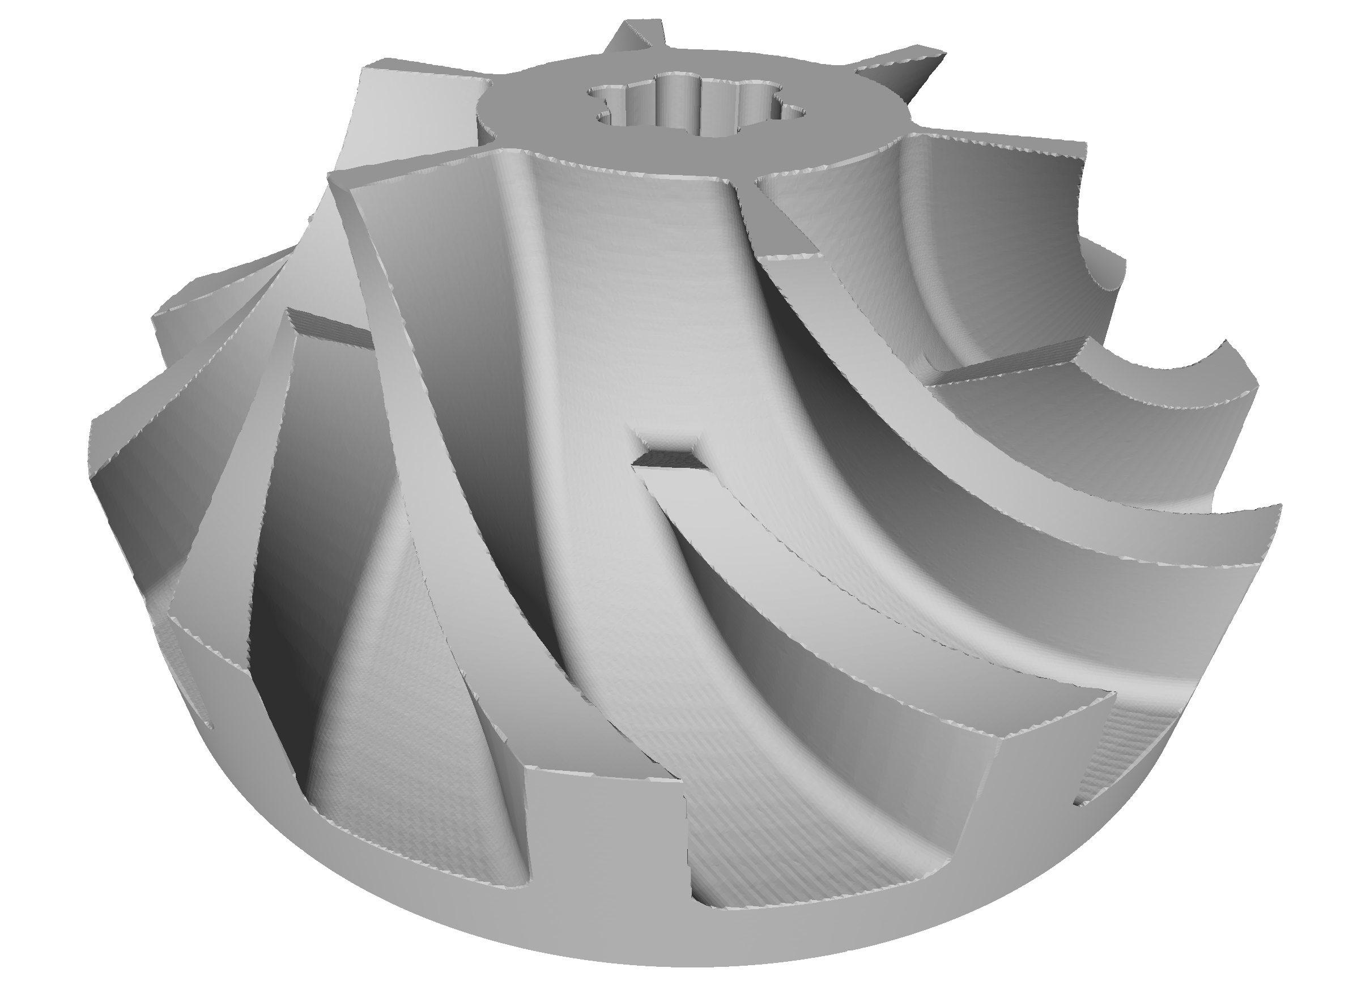
Results – BPA
0.3 + 4.3s
1.9M Δ
3.8 + 3.7s
1.5M Δ

Slide 21
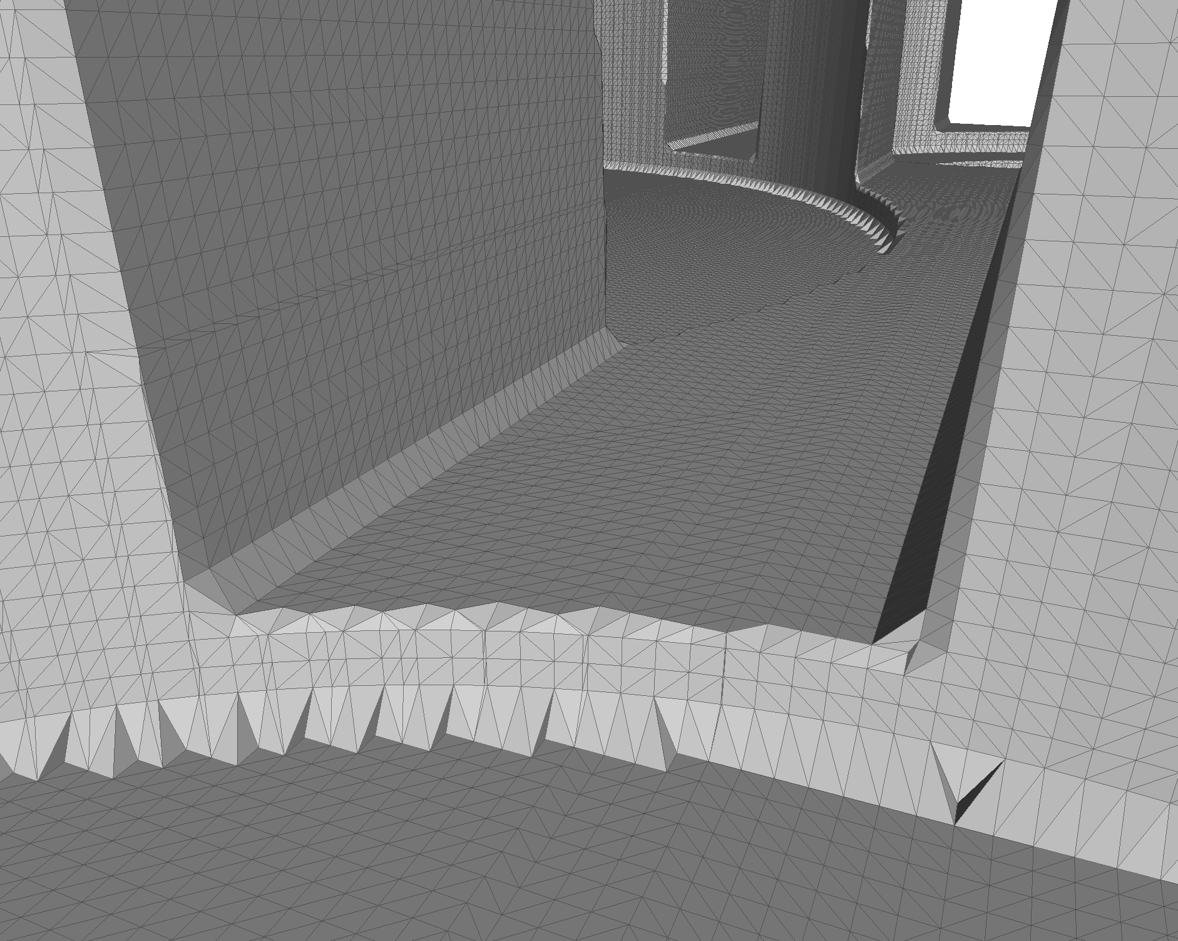
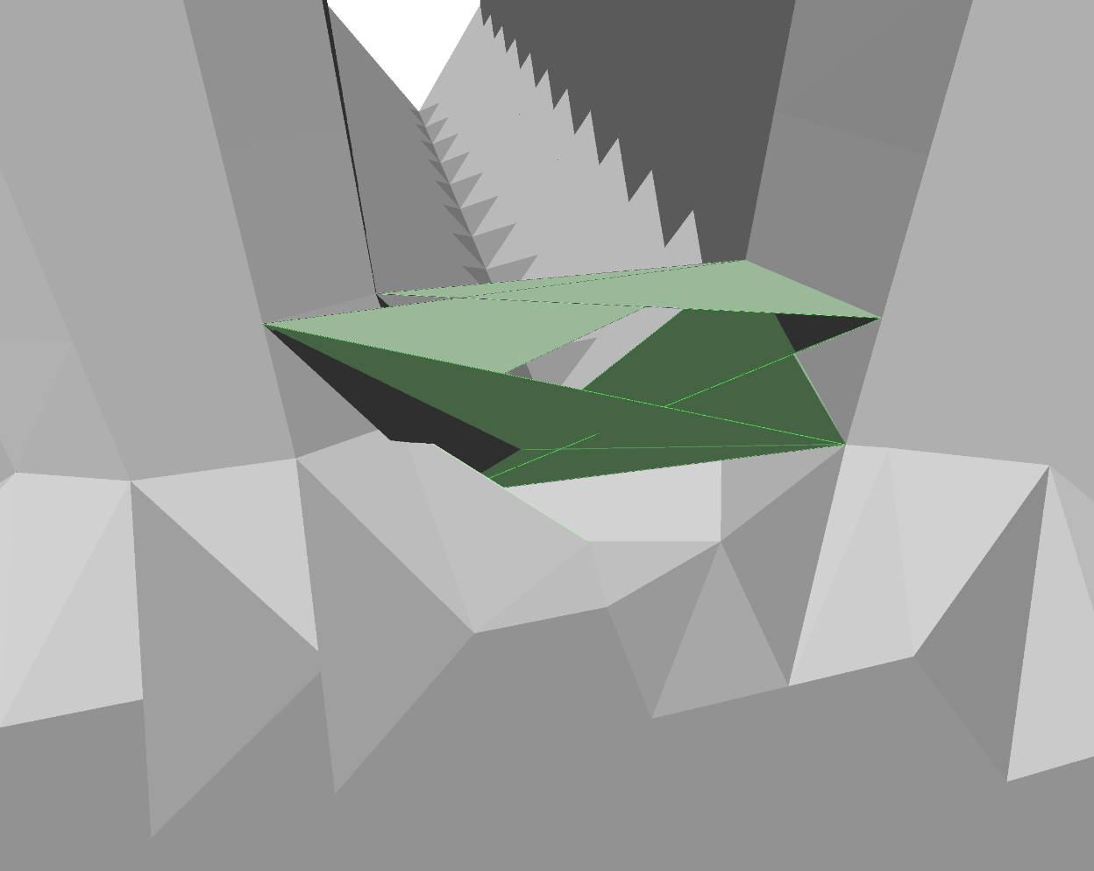
Results – BPA

Slide 22
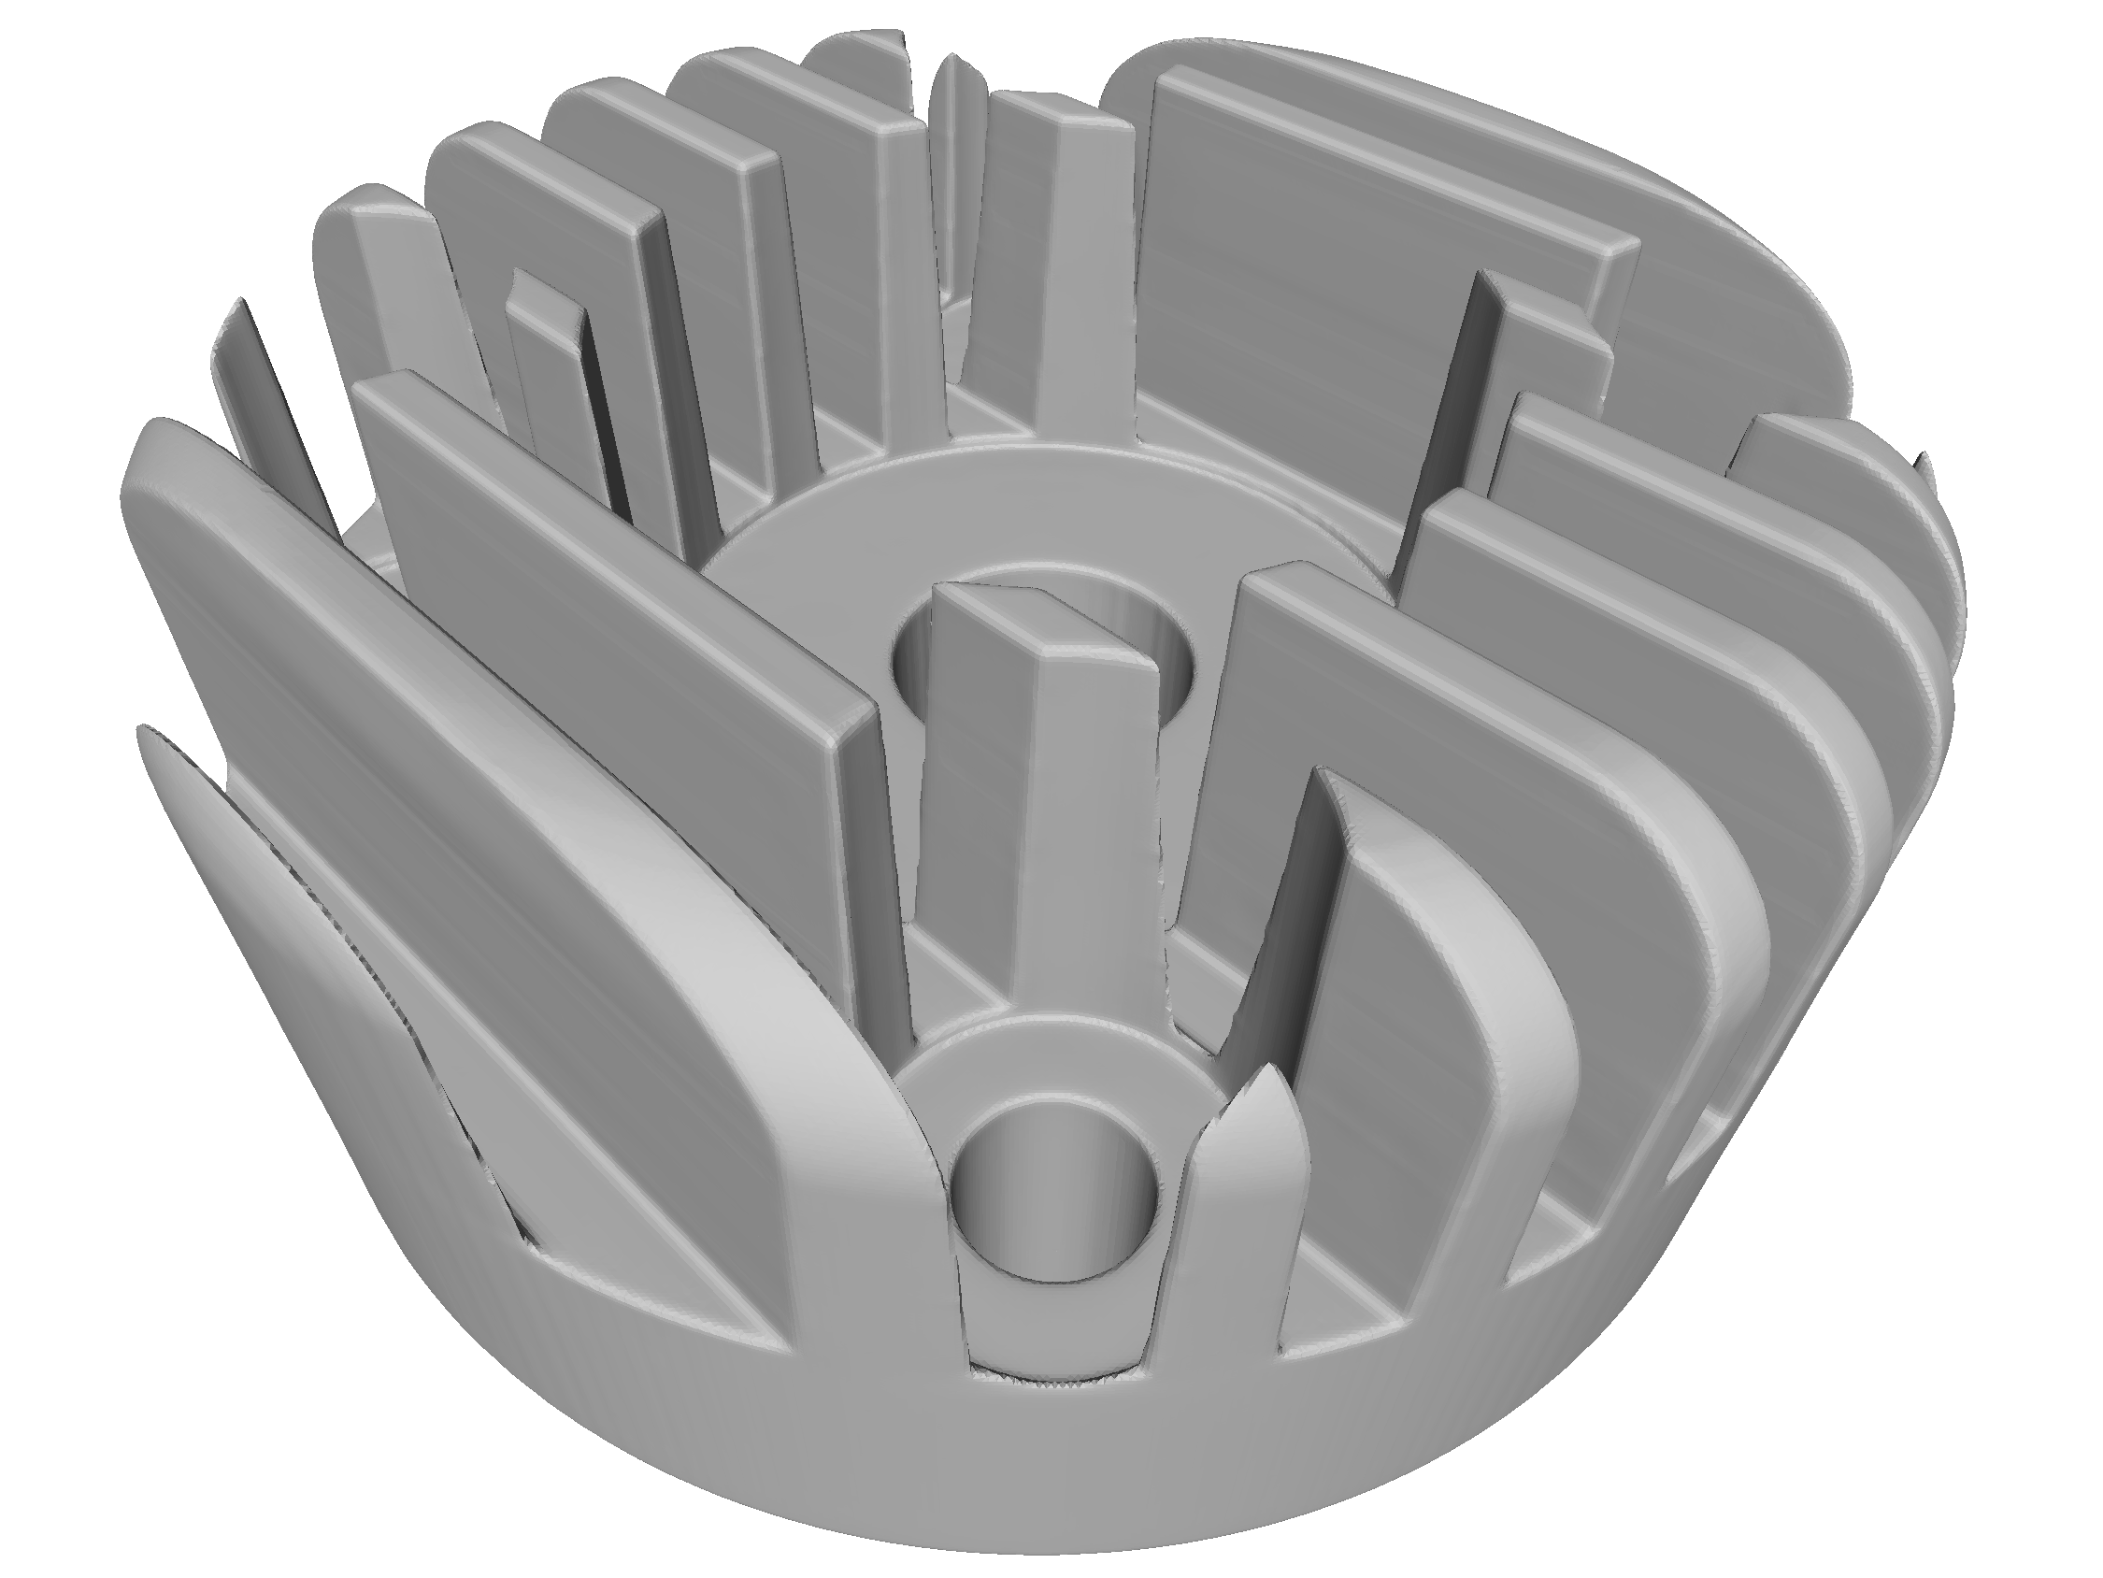
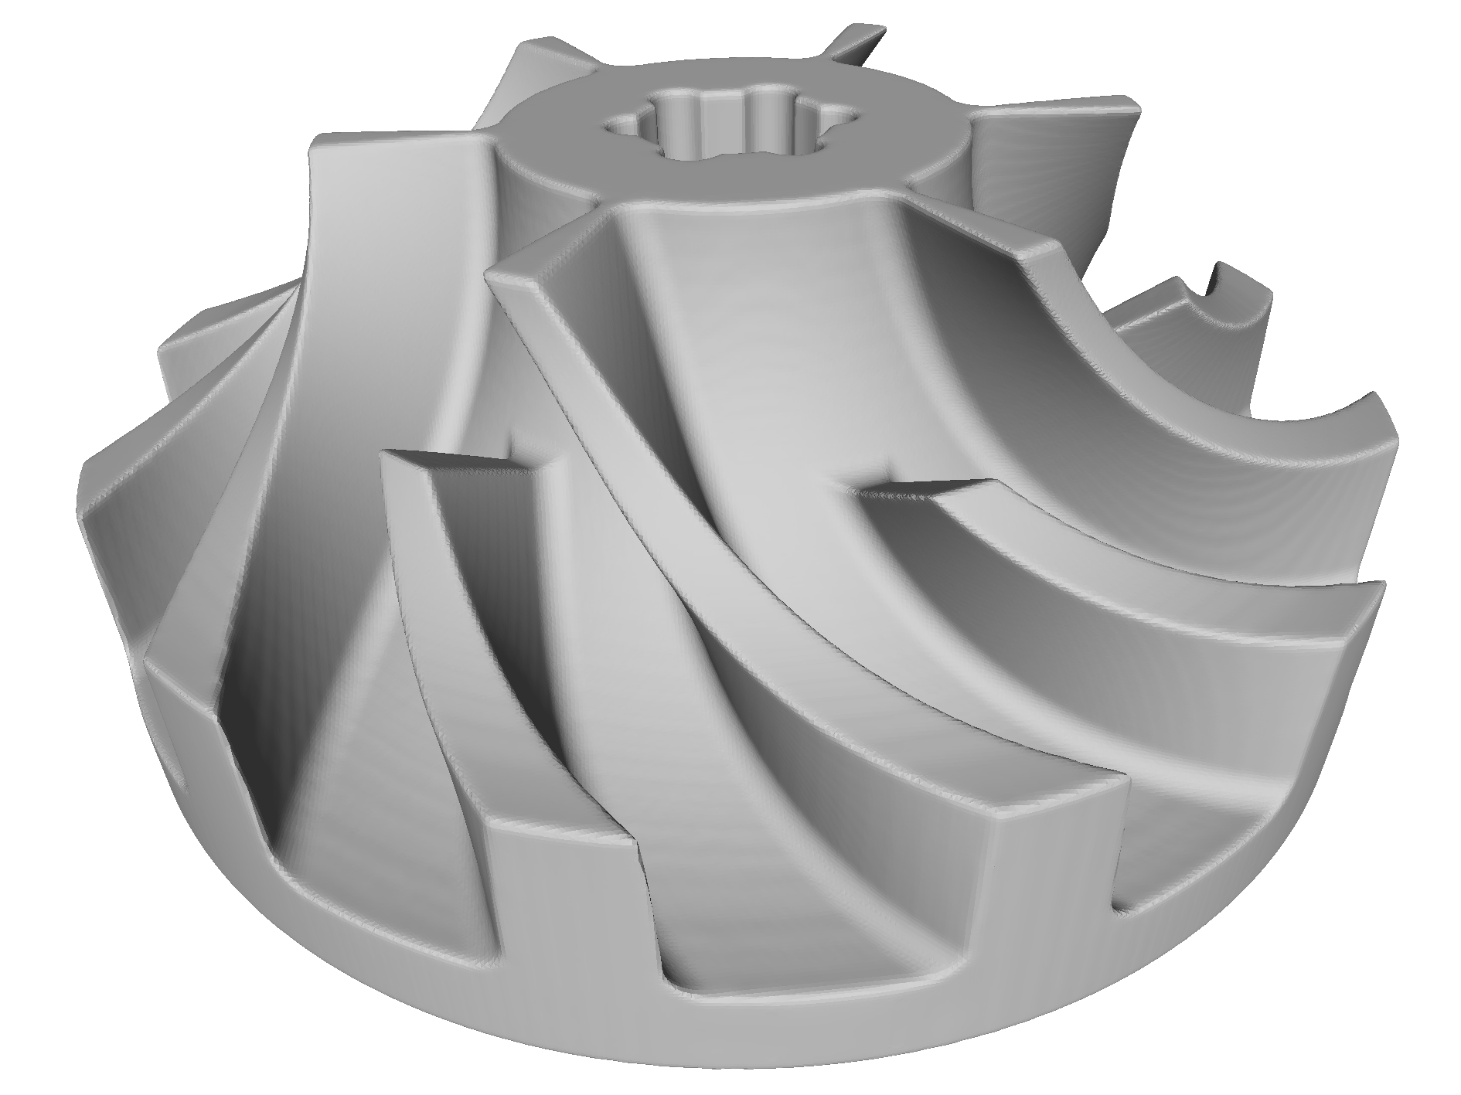
Results – Poisson

Slide 23
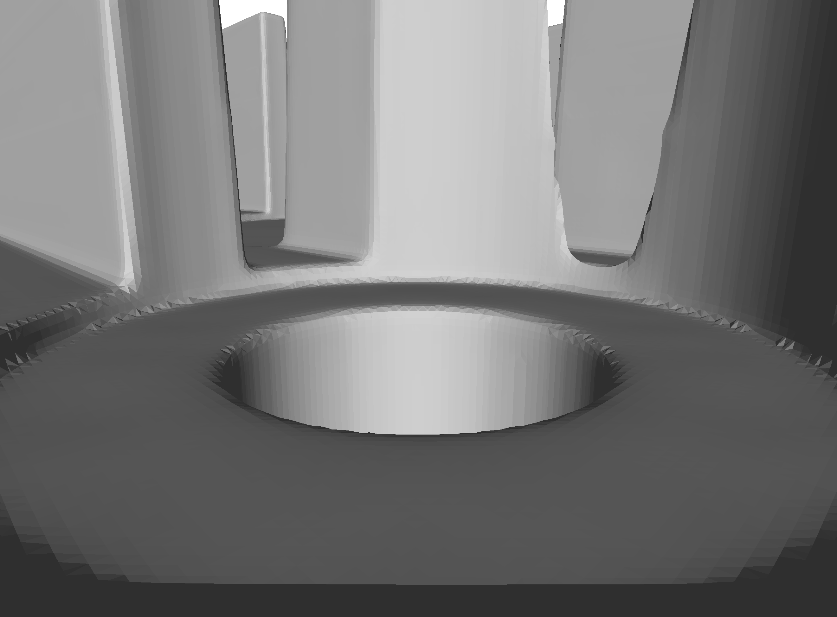
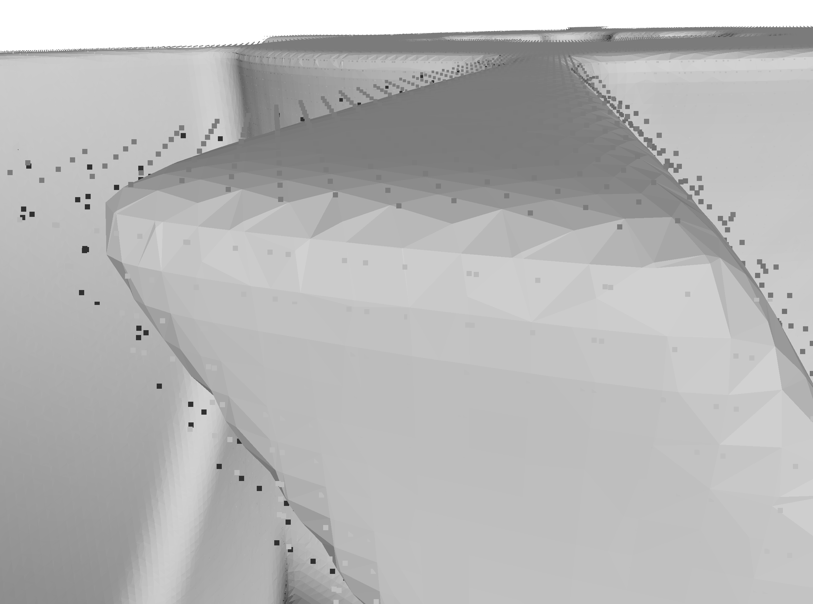
Results – Poisson
Notes:
Dropped further investigation of funcational approaches

Slide 24


Results – Tri-dexel
32s
3.8M Δ
51s
3.0M Δ

Slide 25


Results – Tri-dexel

Slide 26

Conclusion
Direct intersection
fails due to numeric issues
Ball pivoting algorithm
looses concave features
does not use normals
may create holes or role inside
Poisson
Fitting to imprecise in feature-rich regions
Tri-dexel
feature reconstruction using normals
long runtime
Notes:
Finally, based on these results, the tri-dexel approach works best for extracting a triangulated surface from the VML
Will be subject to further research and development

Slide 28
Additional slides

Slide 29




Resolutions – BPA
50
100
200
400

Slide 30




Resolutions – Poisson
50
100
200
400

Slide 31




Resolutions – Tri-dexel
50
100
200
400

Slide 32



Tri-dexel feature reconstruction

Slide 33

Tri-dexel regularization

Slide 34

Tri-dexel cell slicing

